Slide 1
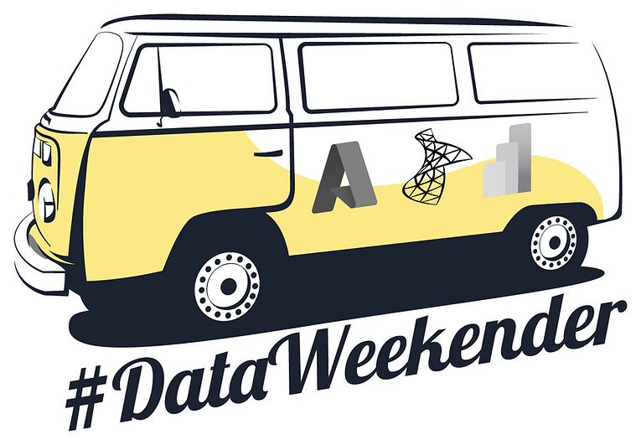
Building the bridge from azure fundamentals to deploying at scale through automation
DataWeekender CU 5
May 2022
Deepthi Goguri + Kay Sauter

Slide 2
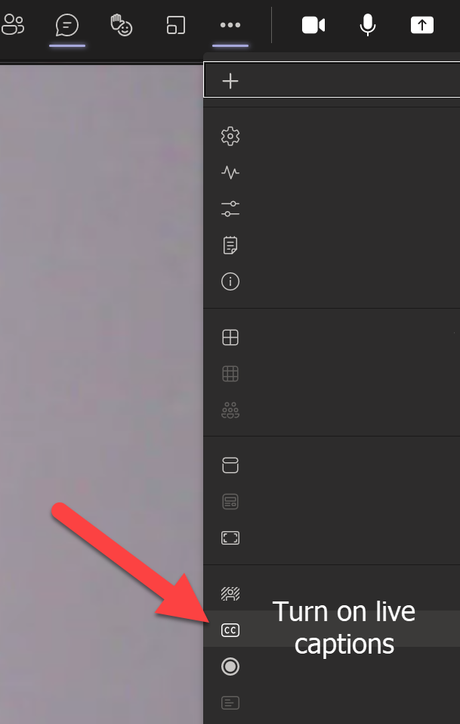
👉Foreword for MS Teams
For zooming in, use CTRL + MOUSE WHEEL
Move around with mouse dragging
Live closed captions in upper right in MS Teams

Slide 3




Deepthi Goguri
DBA
MCT/MCSE
Masters in Computer Technology
Organizer:
DEI user group
Microsoft Data and AI South Florida user group
WIT user group Volunteer
Love Arts, crafts and plants
@dbanuggets
https://www.linkedin.com/in/deepthigoguri/

Slide 4

Kay Sauter (He/Him)
Data Engineer
Working with data since 2008
SQL Server, PBIRS & Azure
User Group Data TGIF founder & leader
DATA BASH Conference organizer
Has bionic ears (Cochlear Implants)
@kaysauter
https://www.linkedin.com/in/kaysauter

Slide 5
Agenda
🤔 Why
👩‍💻 How
ℹ️ Tips

Slide 6
🤔Why would you want that
You want to know the database fundamentals before you move
Database solutions often come at scale, eg. 50+ databases that need to be moved
You don’t want to deploy every single database manually over and over again
Automatize tasks as much as you can – what are the options?

Slide 7
👩‍💻Offering overview
IaaS
VM
PaaS
Azure SQL
Azure Synapse
Azure Databricks
Edge
Hybrid
Windows
Linux
Source:

Slide 8


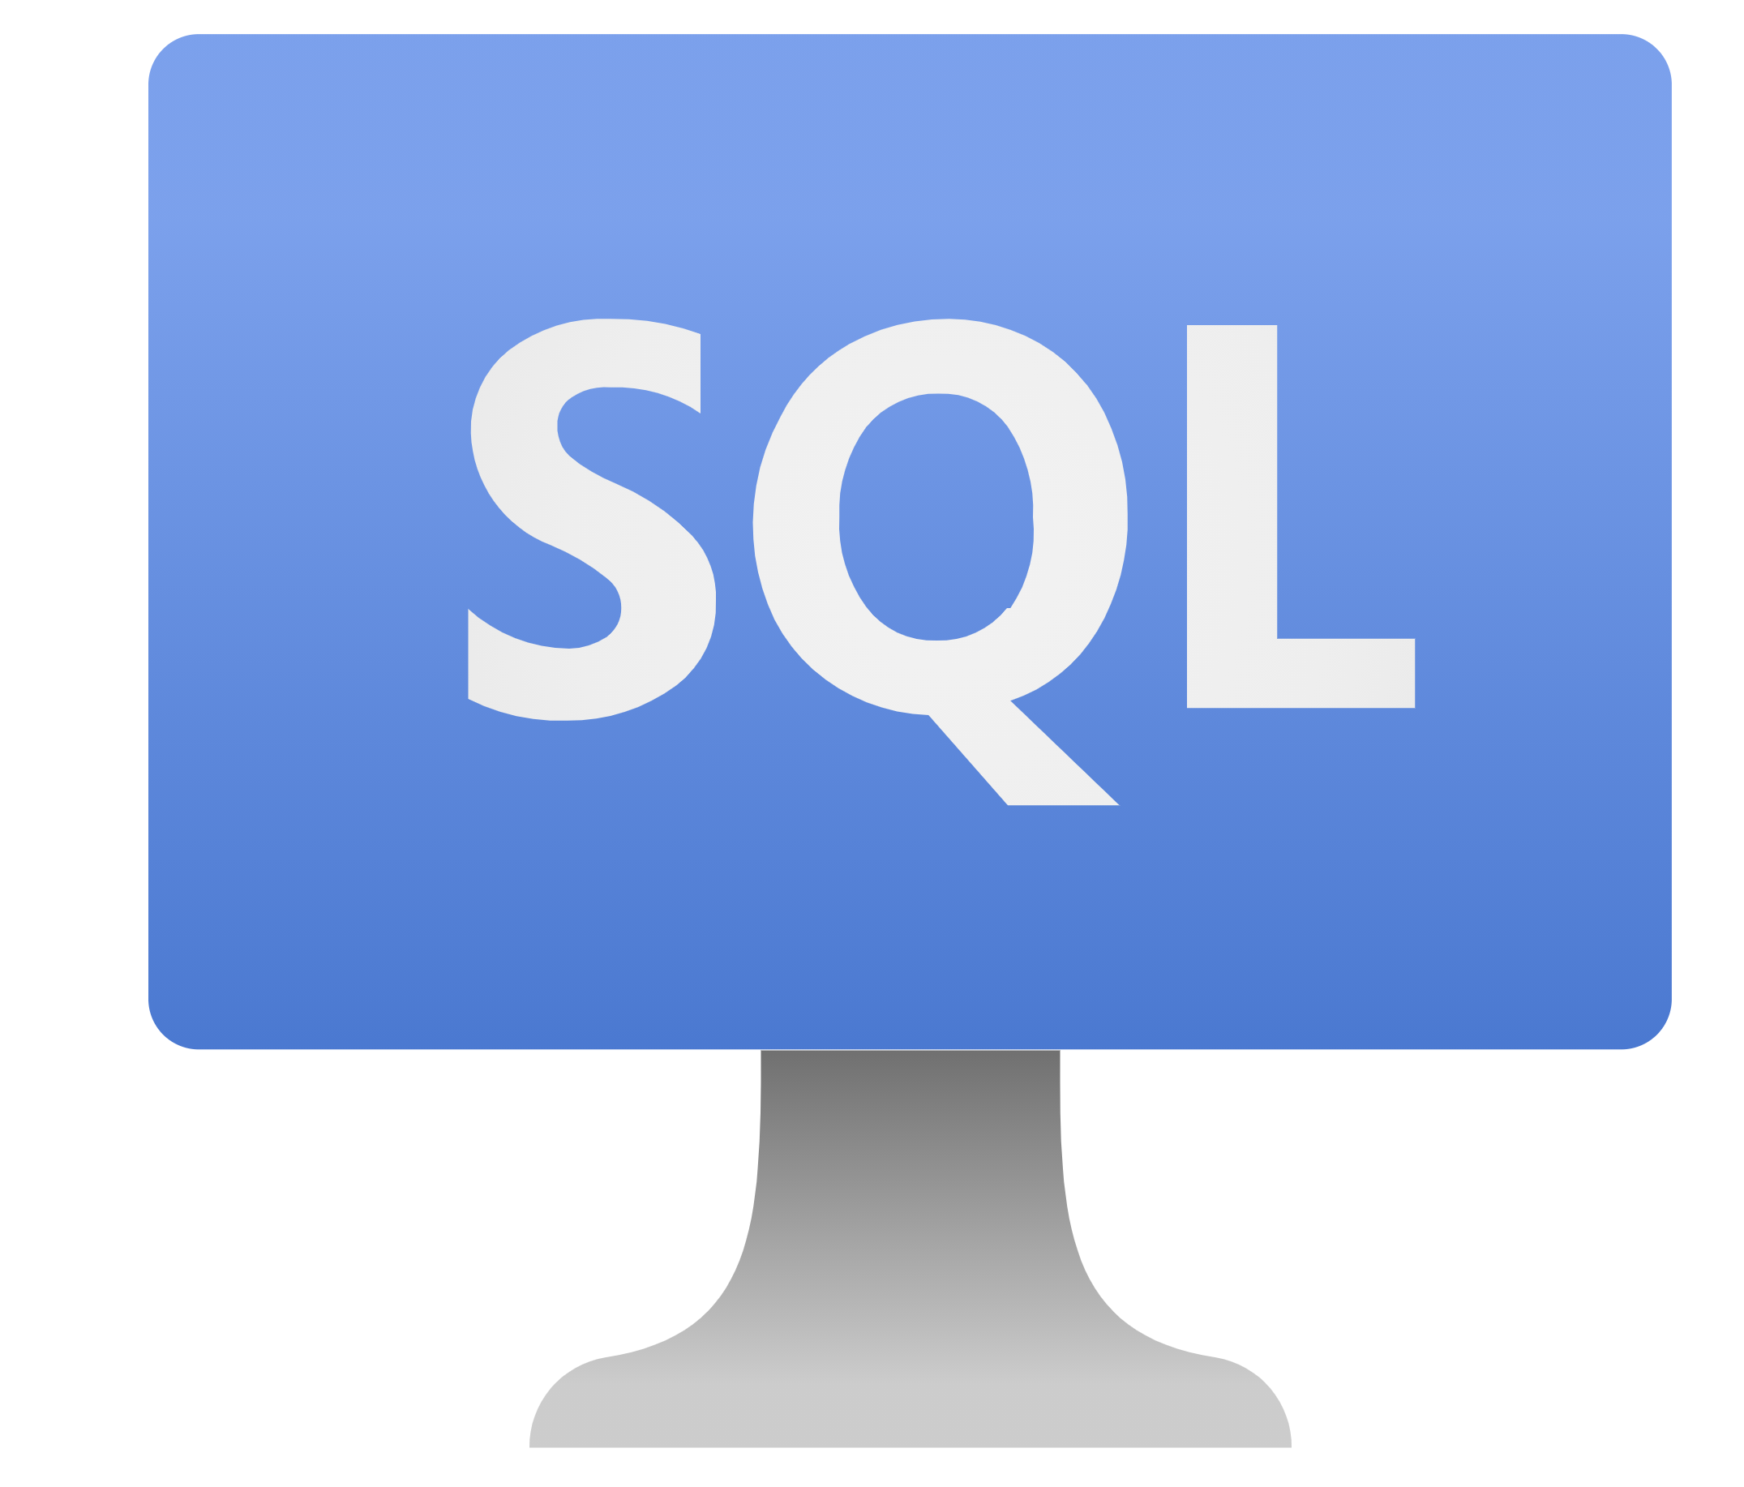
Let’s begin with Fundamentals
SQL Server on Azure VM
SQL Managed Instance
Azure SQL DB
IaaS
Infrastructure as a Service
PaaS
Platform as a Service
PaaS
Platform as a Service

Slide 9
Purchasing Models

Slide 10
DTU | vCore
Bundle together | Individual compute and storage
Easy and simple | Customize and control
Not flexible | Flexible
Azure Hybrid benefit – NO | Azure Hybrid benefit - YES

Slide 11
Service Tiers

Slide 12
Service Tier | General purpose | Business critical | Hyperscale
Purpose | General workloads | Low latency workloads | OLTP, large databases
Compute | 80 vCores | 80 vCores | 80 vCores
Storage type | Remote 5 GB – 4 TB | Local SSD 5 GB – 4 TB | Local SSD cache Up to 100 TB
Backups | 1 to 35 days (7 as Default) | 1 to 35 days (7 as Default) | 1 to 35 days (7 as Default)
Availability | 1 replica, no Read Scale-out, zone-redundant HA (preview), no local cache | 3 replicas, 1 Read Scale-out, zone-redundant HA, full local storage | Multiple replicas, up to 4 Read Scale-out, zone-redundant HA (preview), partial local cache
In-memory | Not supported | Supported | Not supported
IOPS | 500 per vCore with max 7,000 | 5,000 with max 200,000 | Multi-tiered architecture Effective IOPS will depend on the workload

Slide 13
Compute Tiers

Slide 14
Provisioned | Serverless
Unpredictable workloads | Predictable workloads
Manual scaling | Automatic scaling
No pause | Pause the database
Pay for the fixed resources you choose | Pay only while database in use
Per hour billing | Per second billing

Slide 15
How will my Data be protected?

Slide 16
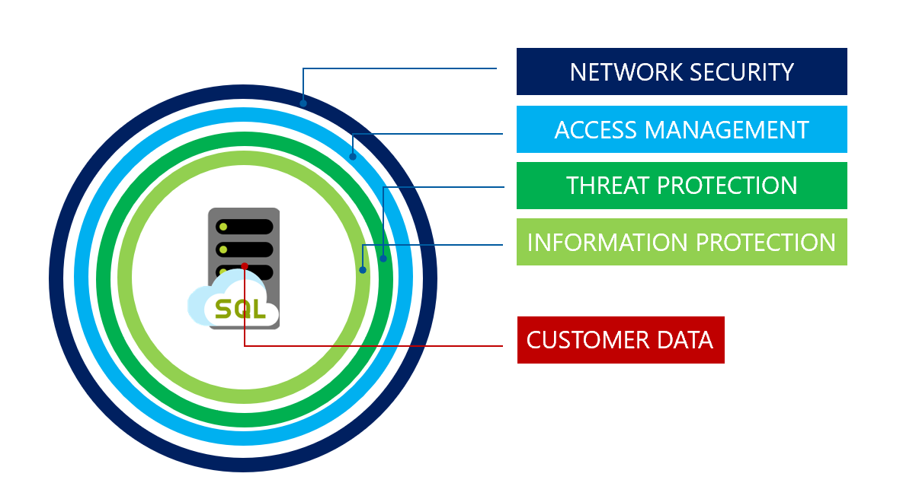
Illustration by Microsoft, https://docs.microsoft.com/en-us/azure/azure-sql/database/security-overview

Slide 17
Network Security

Slide 18
Allow Access to Azure Services | Firewall rules | Virtual network rules | Private link
Least secure | Secure with firewall | Private IP address of the Azure VM | Most secure
Anything in Azure can connect | Services with added Firewall rules can connect | Any resource in that VN can access Azure SQL | Block all public access
Outside of Azure cannot connect | Allow on-prem connections | Apply virtual network technologies to connect on-prem | Private IP address within a specific virtual network
Public IP address | Public IP address | Private IP address within the VN | Private IP address
DNS hierarchy is public | DNS hierarchy is public (region, cr) | DNS hierarchy is still public (region, cr) | DNS hierarchy shows private endpoint
Source: https://docs.microsoft.com/en-us/shows/learn-live/azure-sql-fundamentals-episode-3-secure-your-data-with-azure-sql

Slide 19
Access Management

Slide 20
Authentication
Authorization
Proving the user
Both Azure SQL and MI supports
SQL Auth
Azure AD Auth
MFA
Controlling access to resources
Both Azure SQL and MI supports
Database roles
Custom roles
Row-level security

Slide 21
RBAC
⋆ What can and cannot be done to the resources?
⋆ Owner - I can do everything (read, modify and assign)
⋆ Contributor - I can read and modify but not assign
⋆ Reader - I can only read
⋆ Permissions to subscriptions, resource groups and resources. Can be inherited.

Slide 22
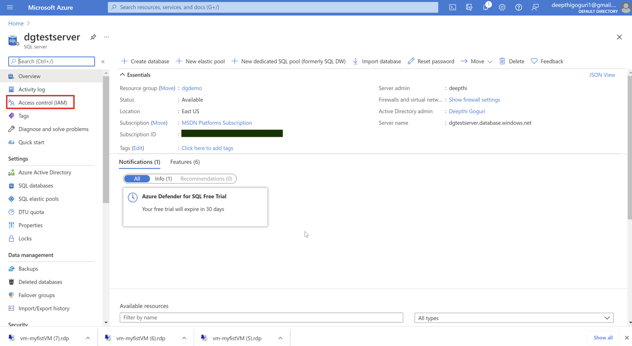

Slide 23
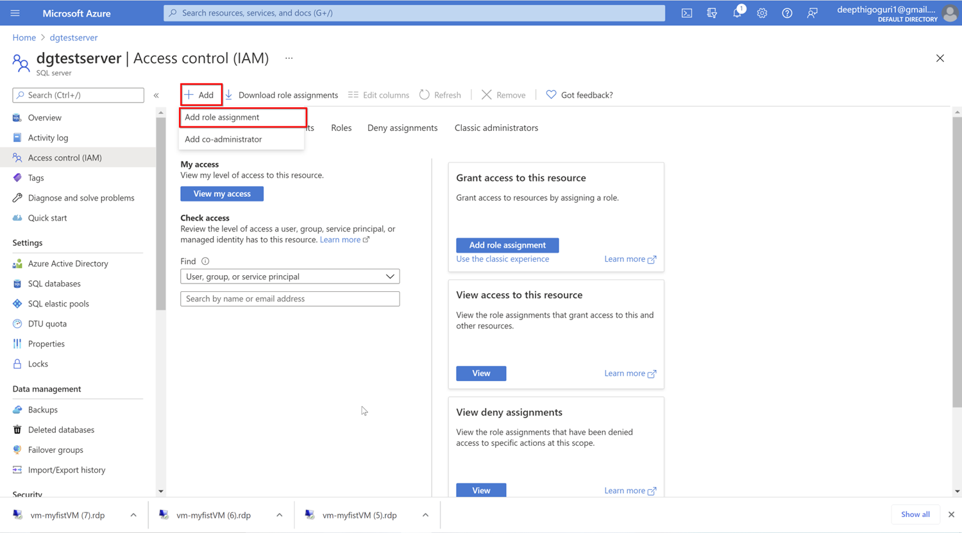

Slide 24
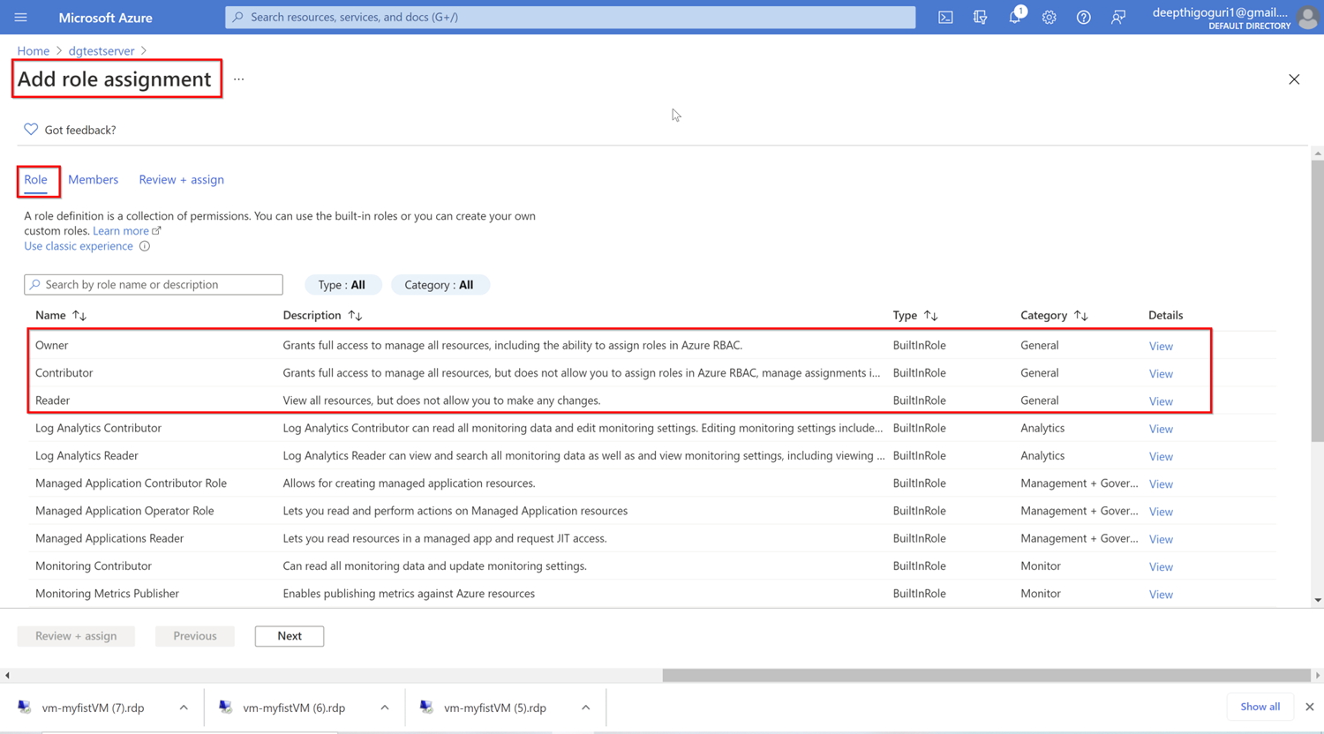

Slide 25
Threat protection

Slide 26
SQL Auditing
Database activities
Saved to Azure storage account
Microsoft Defender for SQL
Vulnerability assessment
Suspicious activity detection
Action steps to resolve the issue
Data Discovery and Classification

Slide 27
Information protection

Slide 28
Transport Layer Security (Encryption-in-transit)
- cloud services and customers
Transparent Data Encryption (Encryption-at-rest)
Certificate maintenance
Rotation by Service
Key management – Azure Key Vault
Always Encrypted (Encryption-in-use)
encrypt data within client applications prior to storing it in Azure SQL Database
Requirement: need to have access to encryption key
Stored in Key vault
Dynamic Data Masking
Masking sensitive data
Source: https://docs.microsoft.com/en-us/azure/security/fundamentals/encryption-overview

Slide 29
Create Azure SQL DB

Slide 30
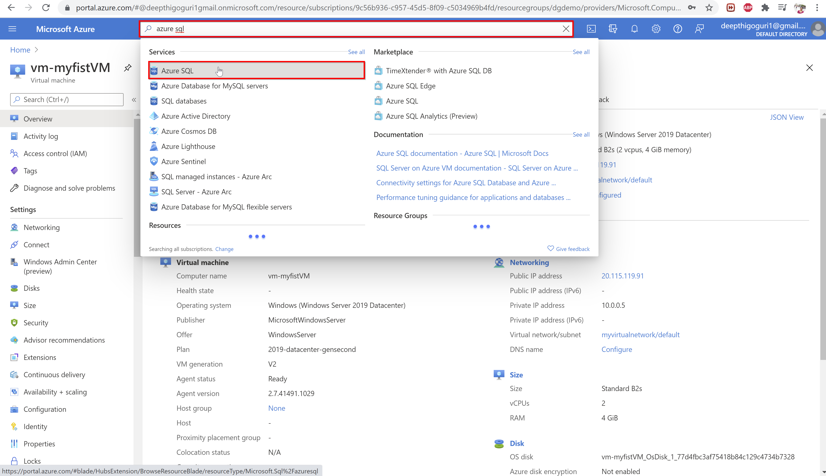

Slide 31
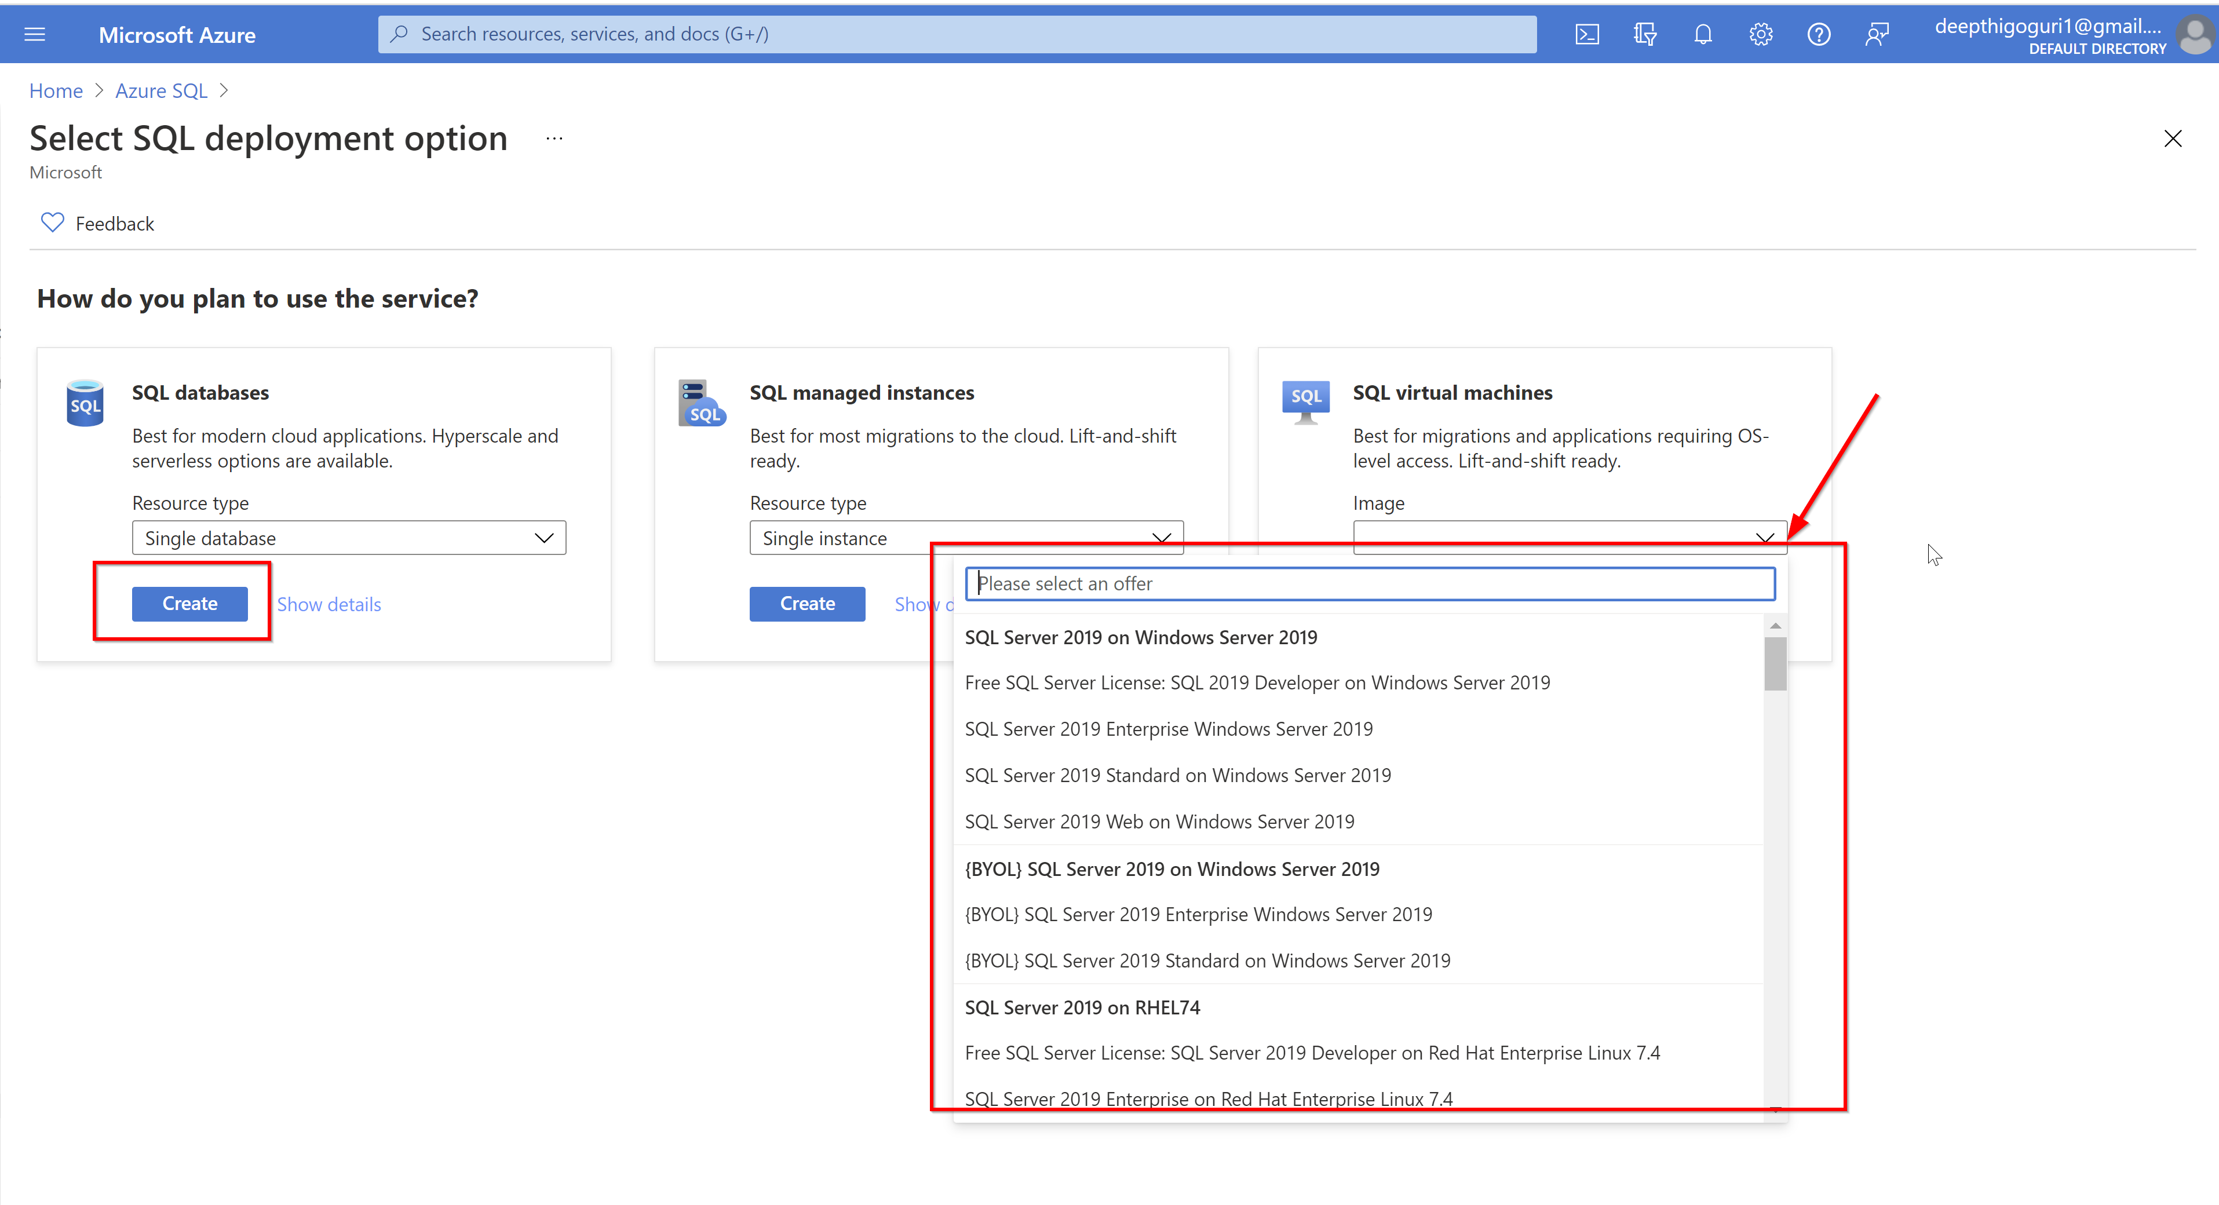

Slide 32
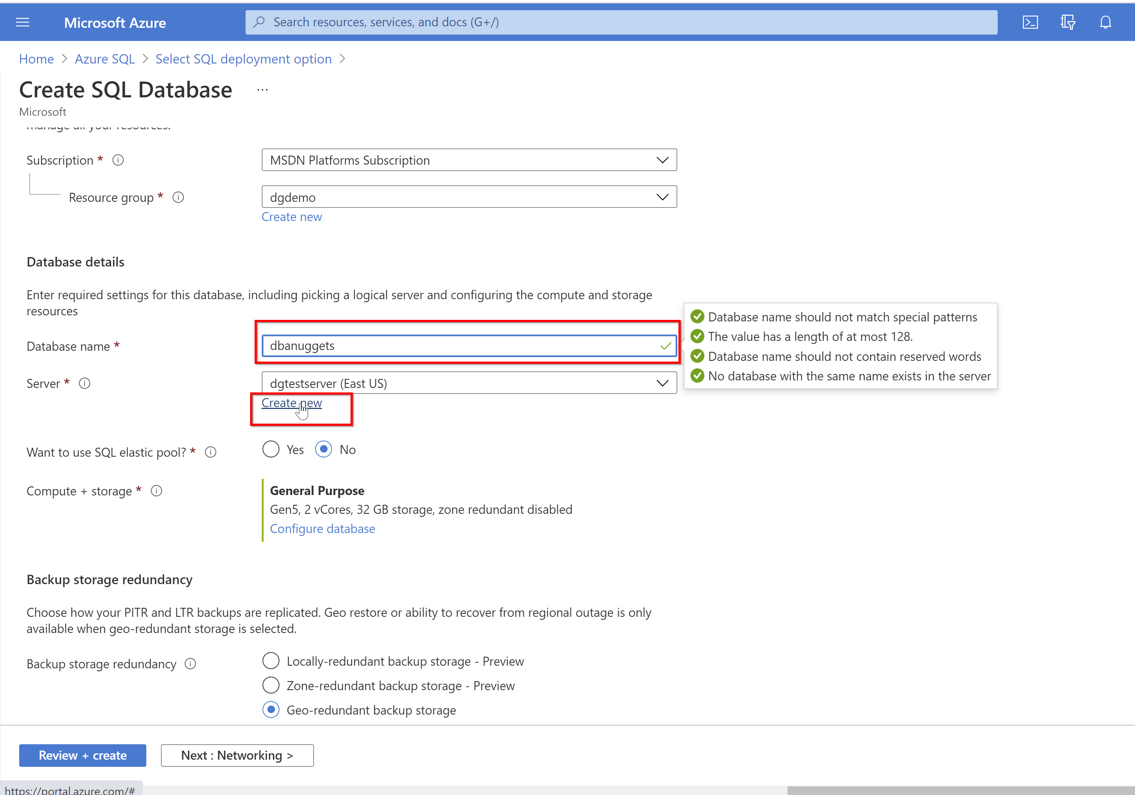

Slide 33
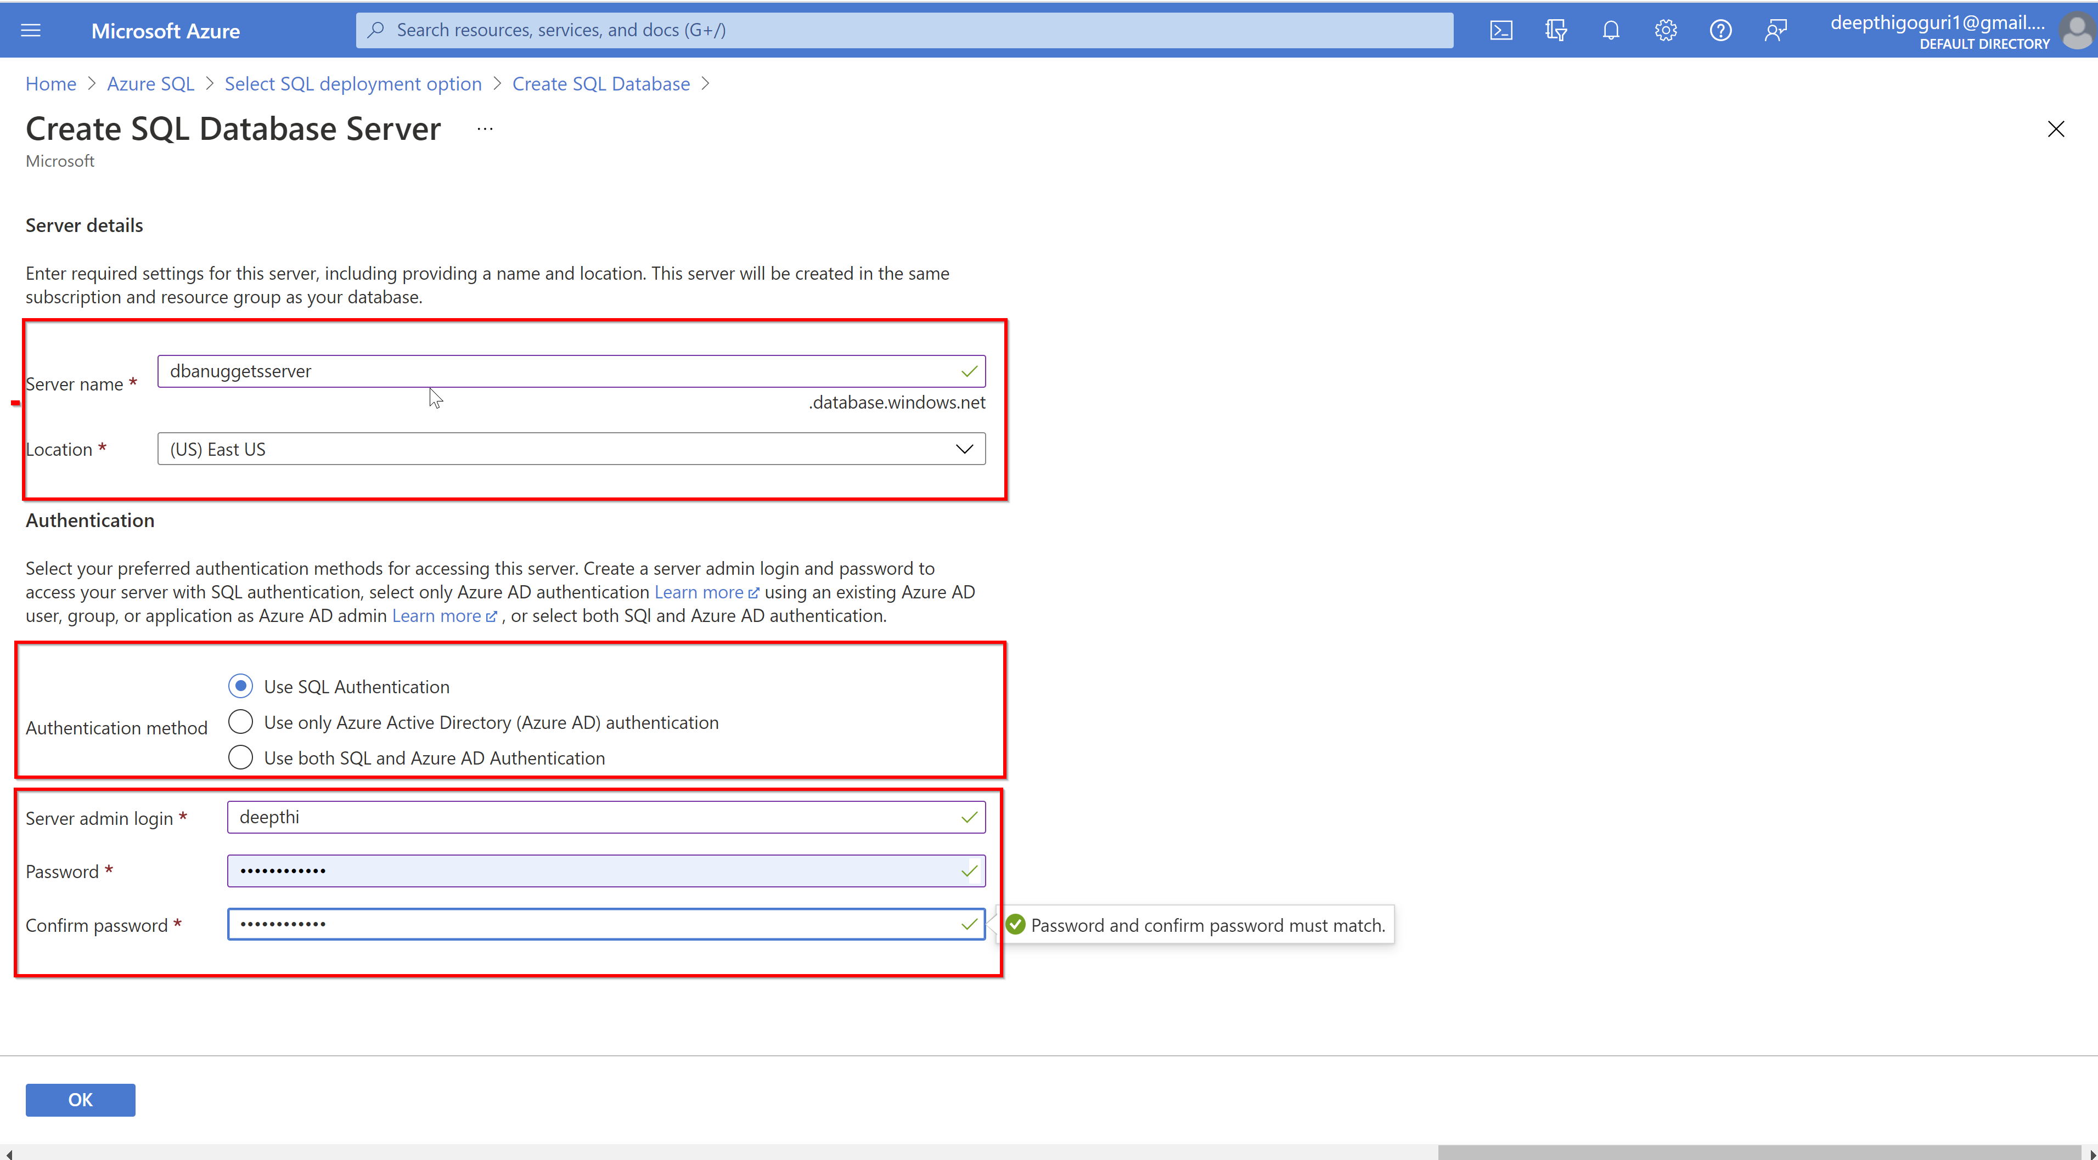

Slide 34
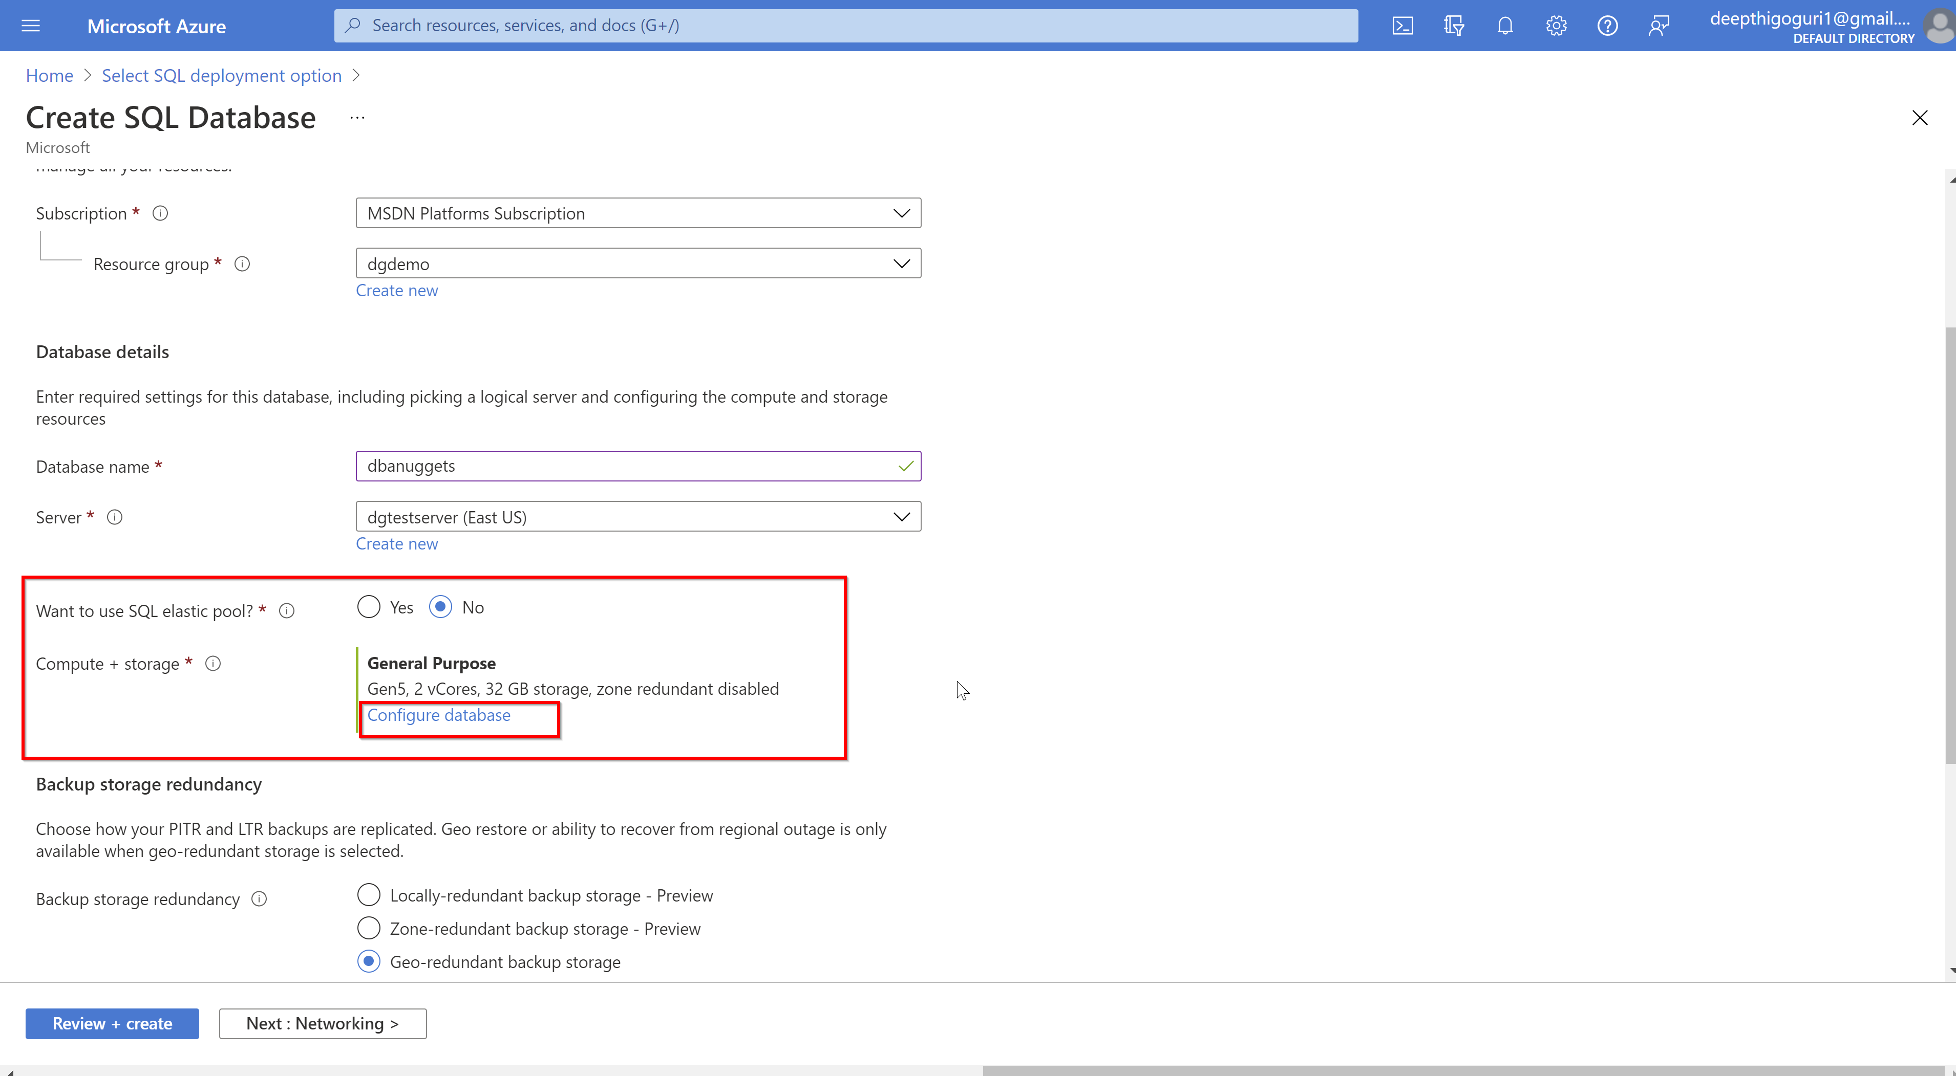

Slide 35
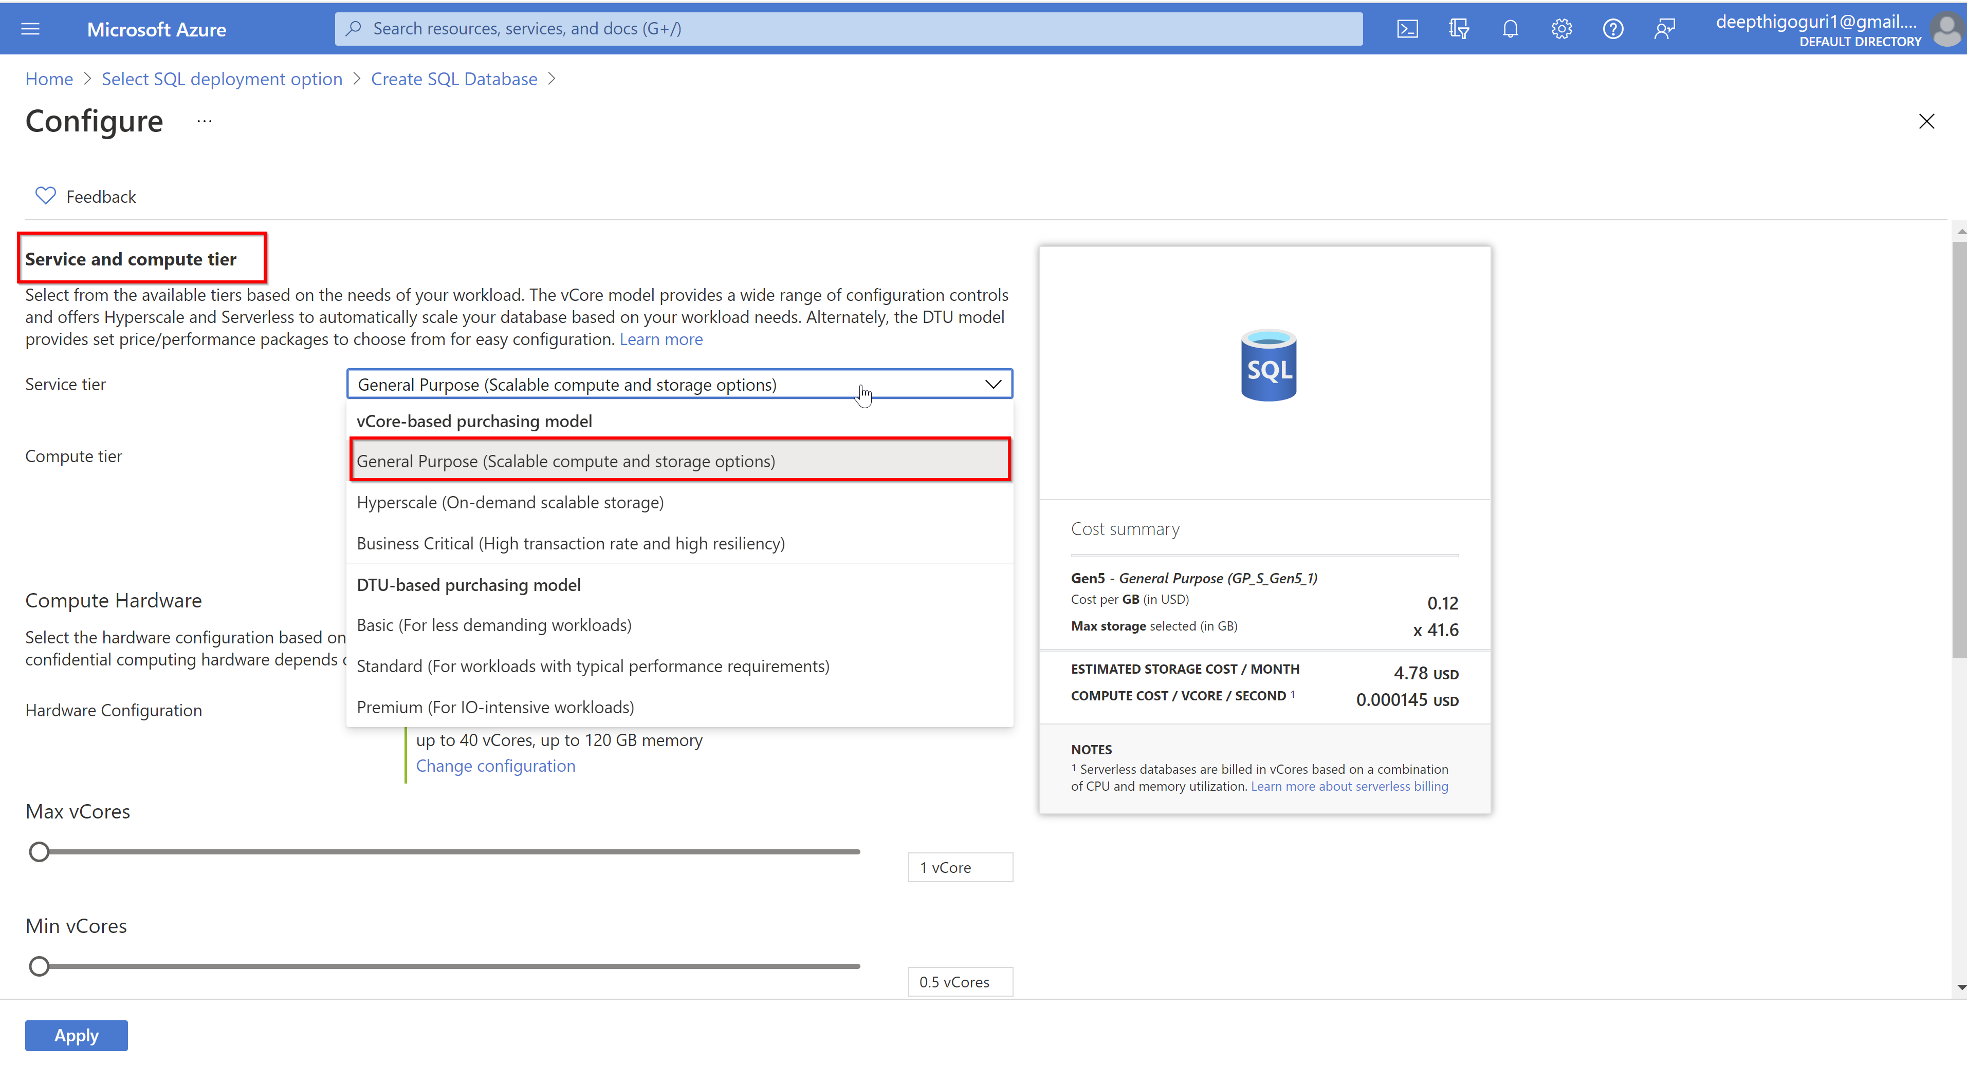

Slide 36
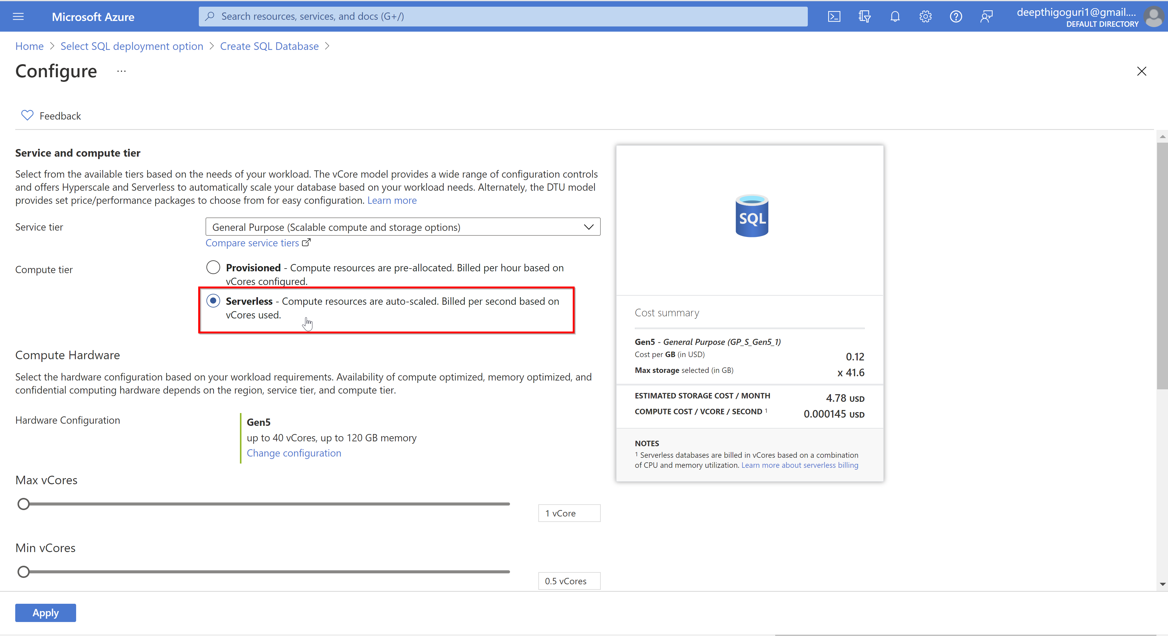

Slide 37
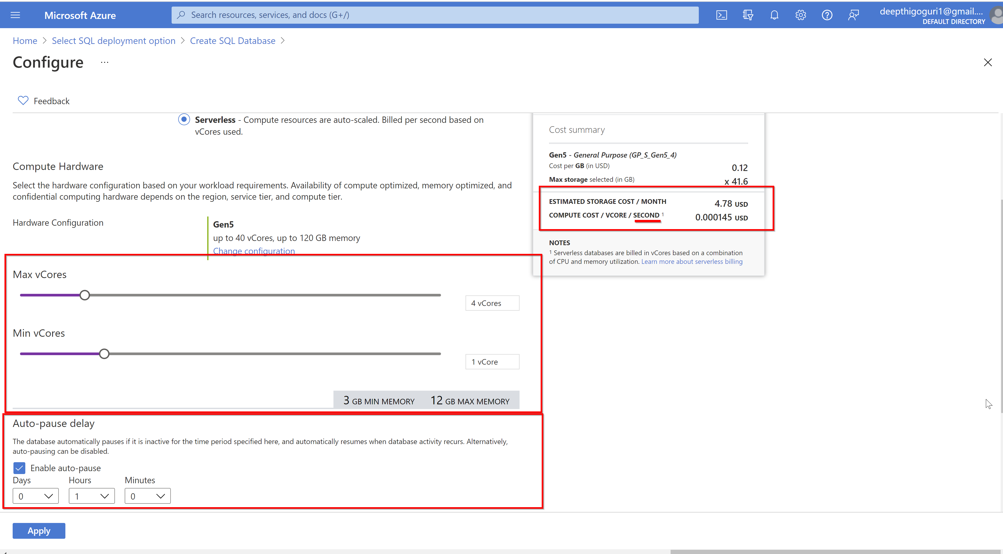

Slide 38
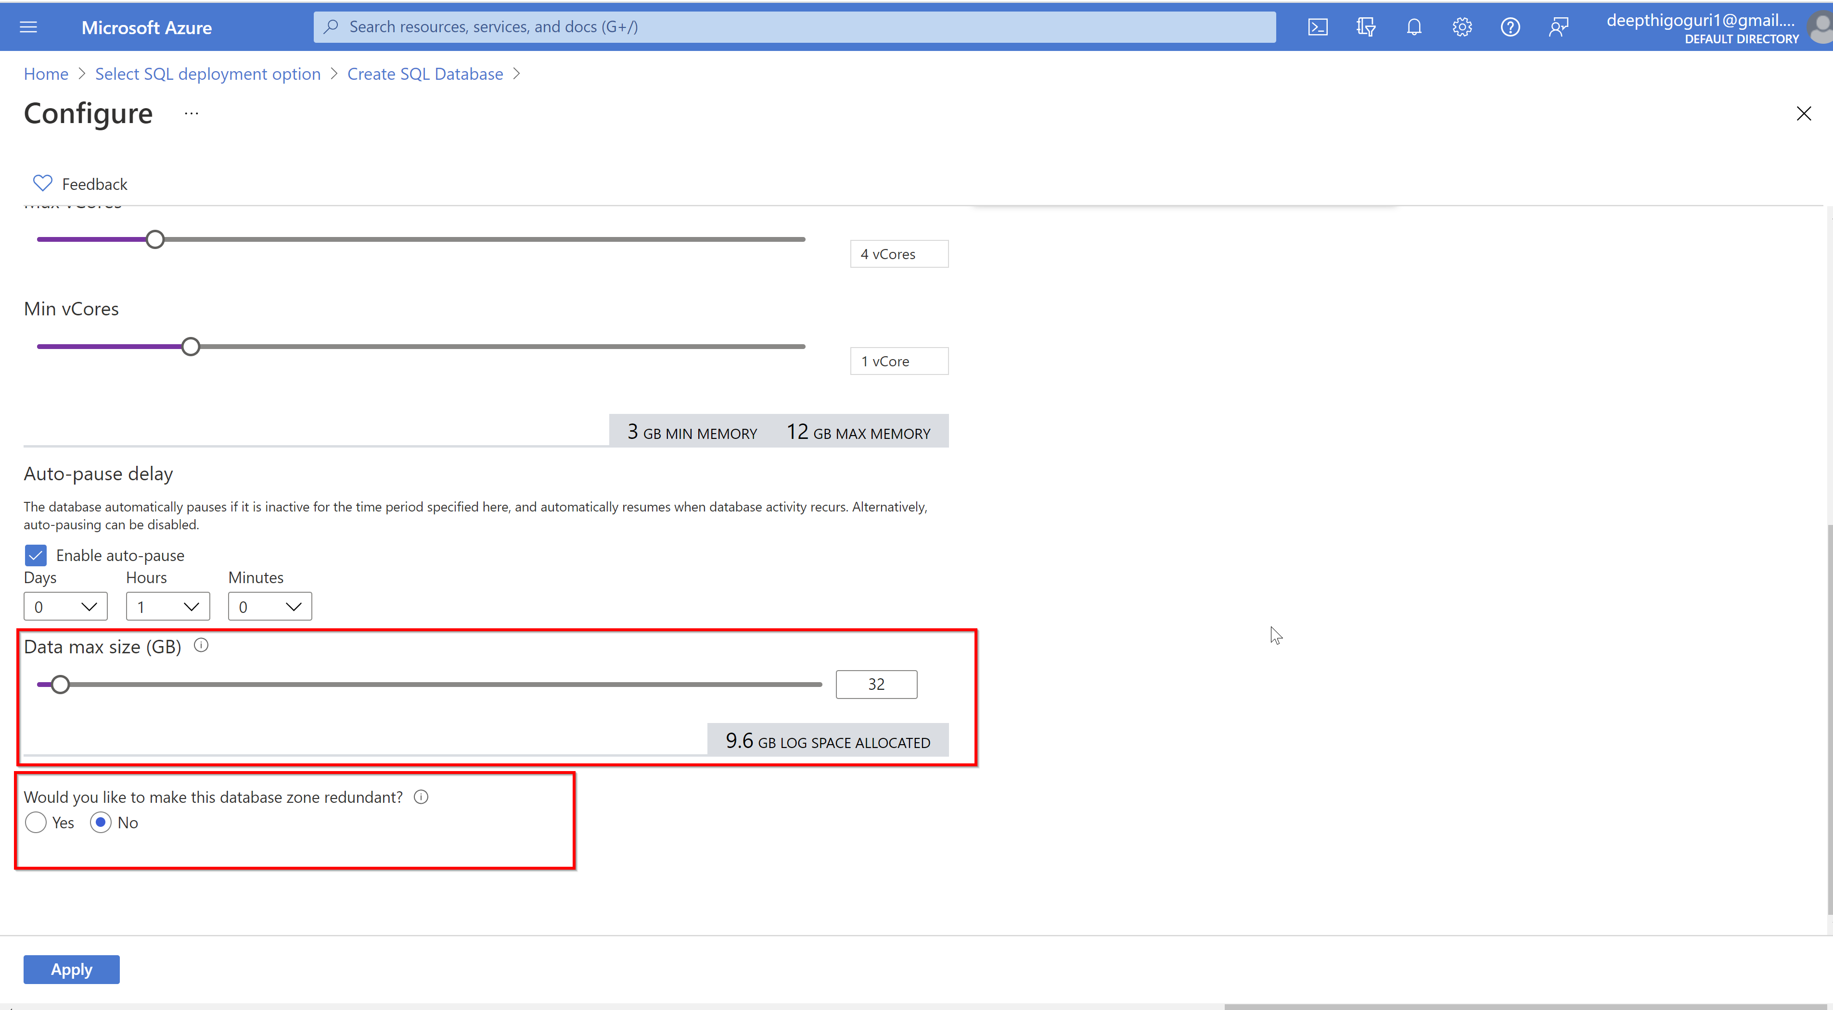
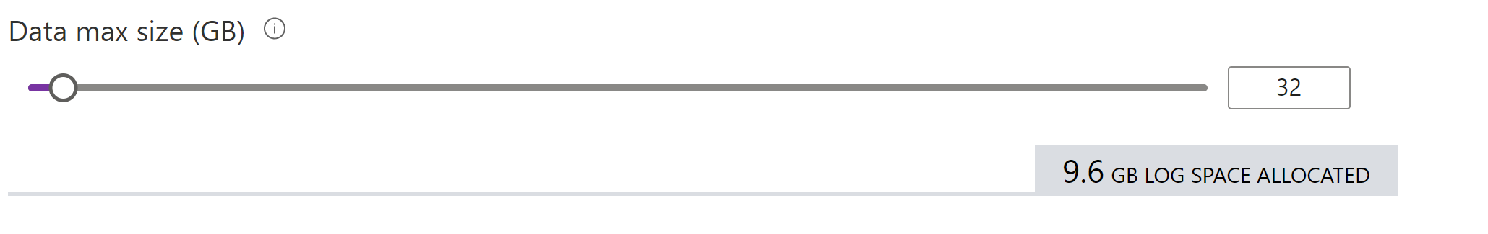

Slide 39
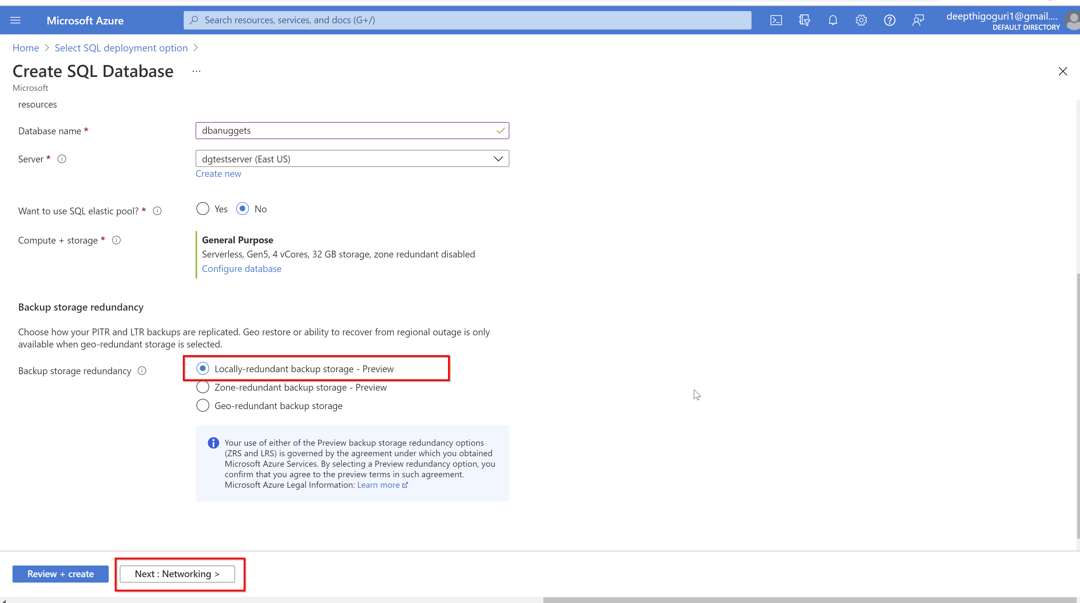

Slide 40
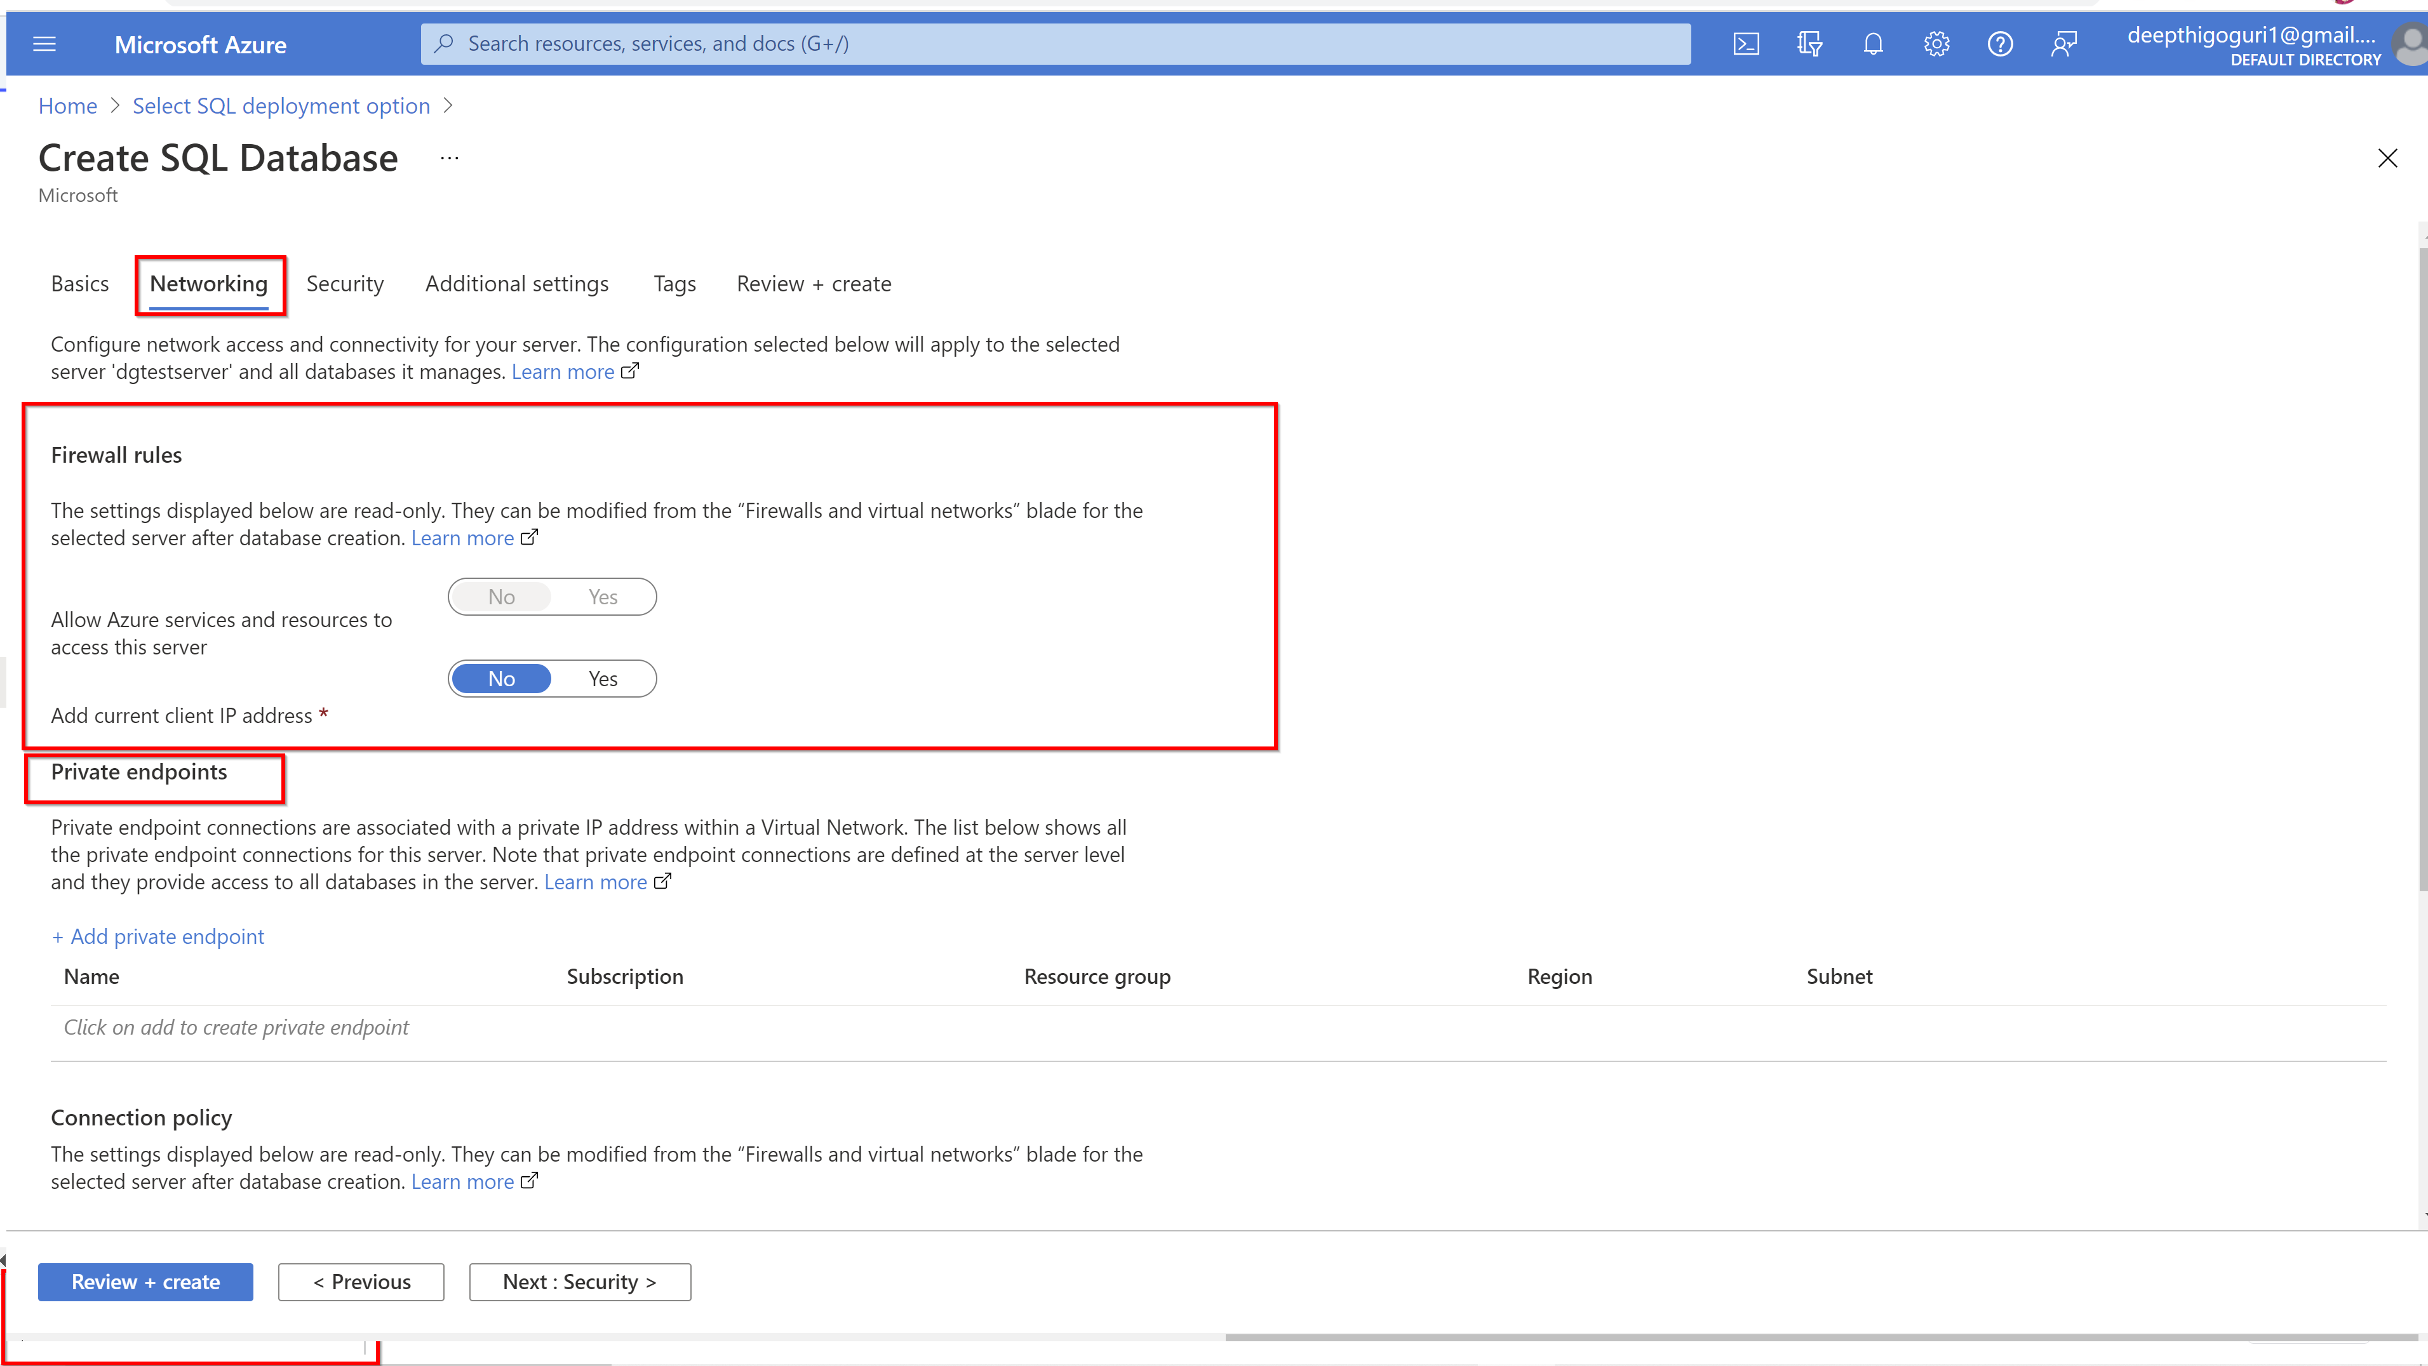

Slide 41
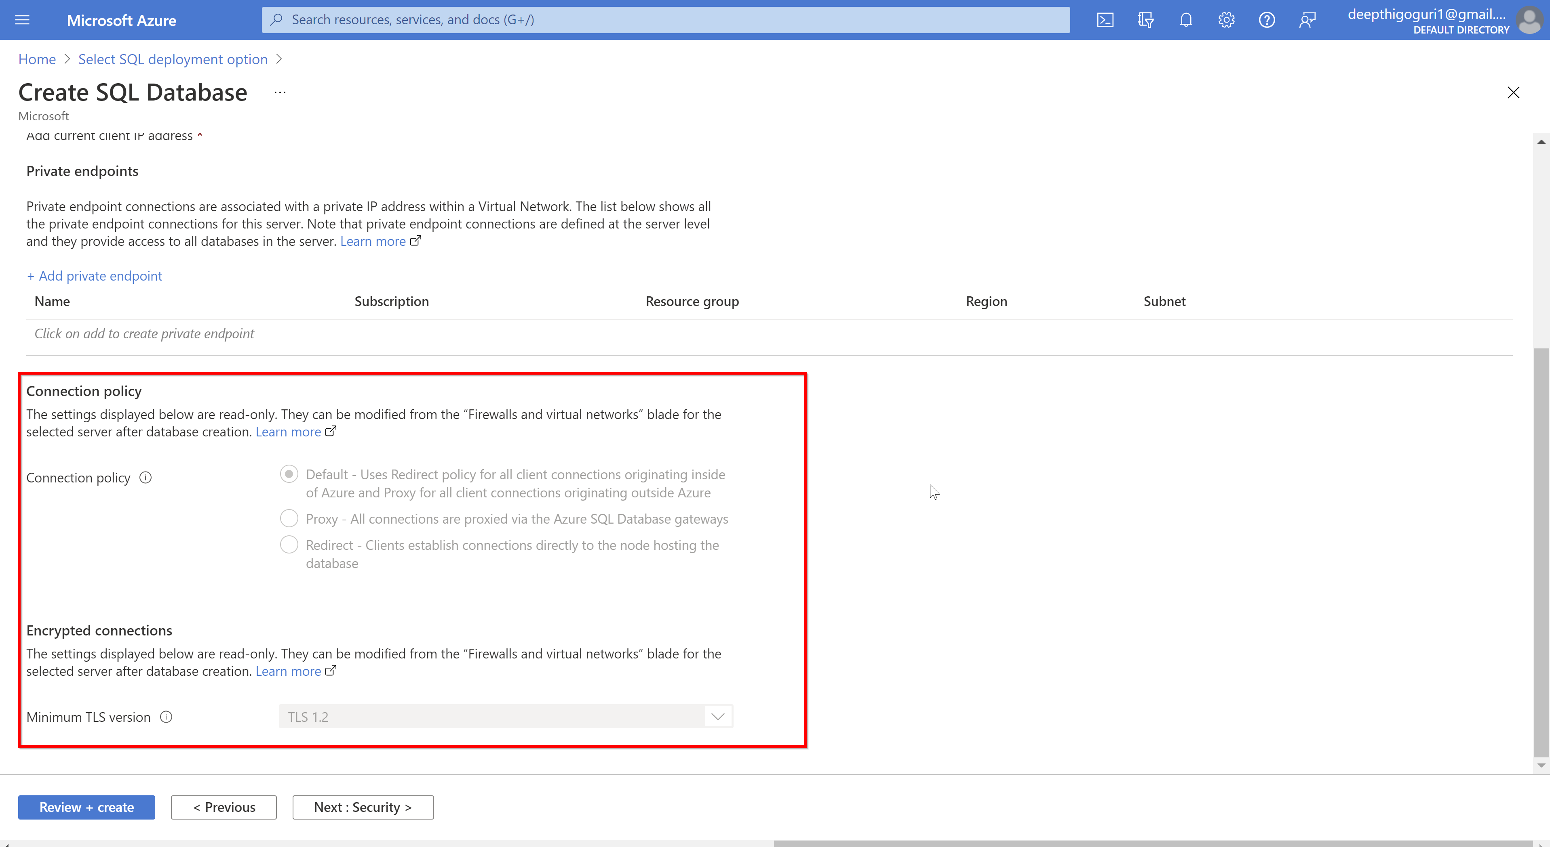

Slide 42
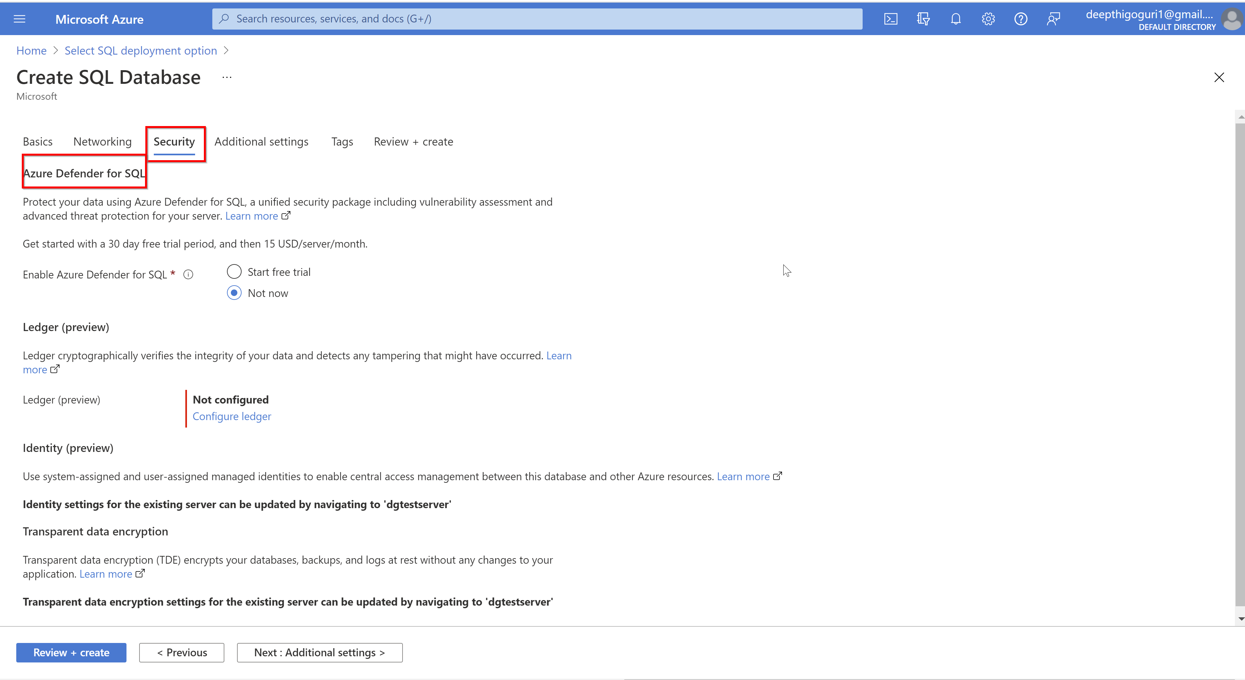

Slide 43
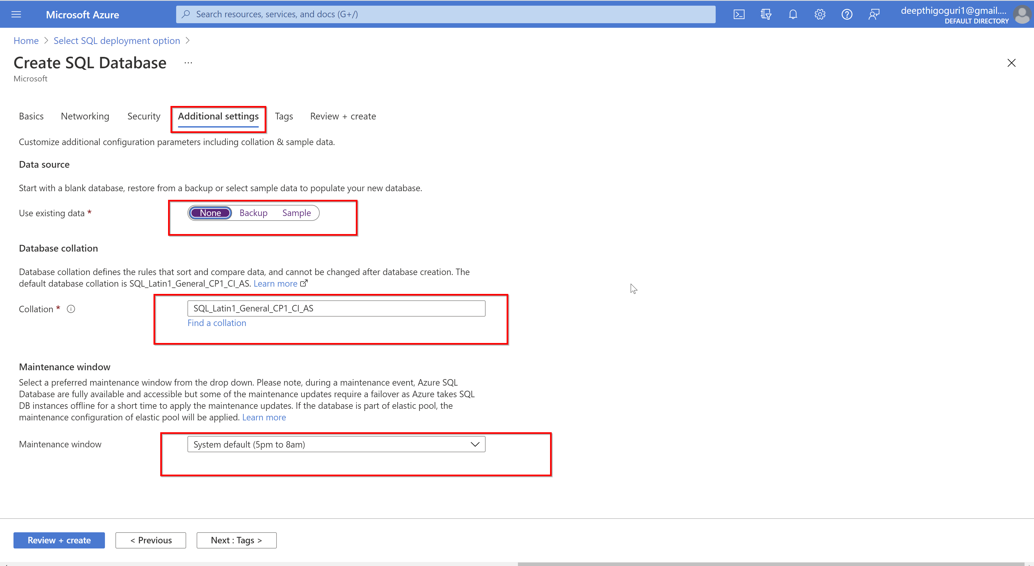

Slide 44
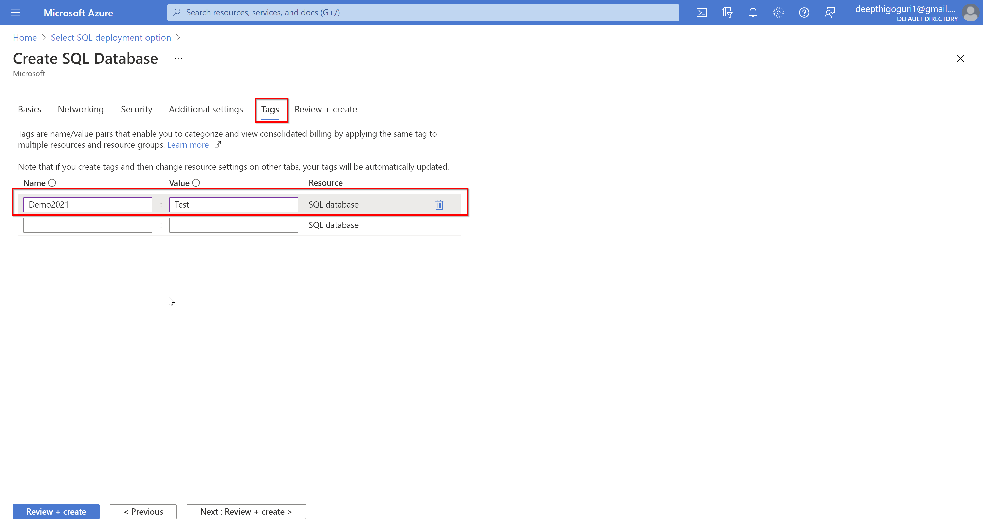

Slide 45
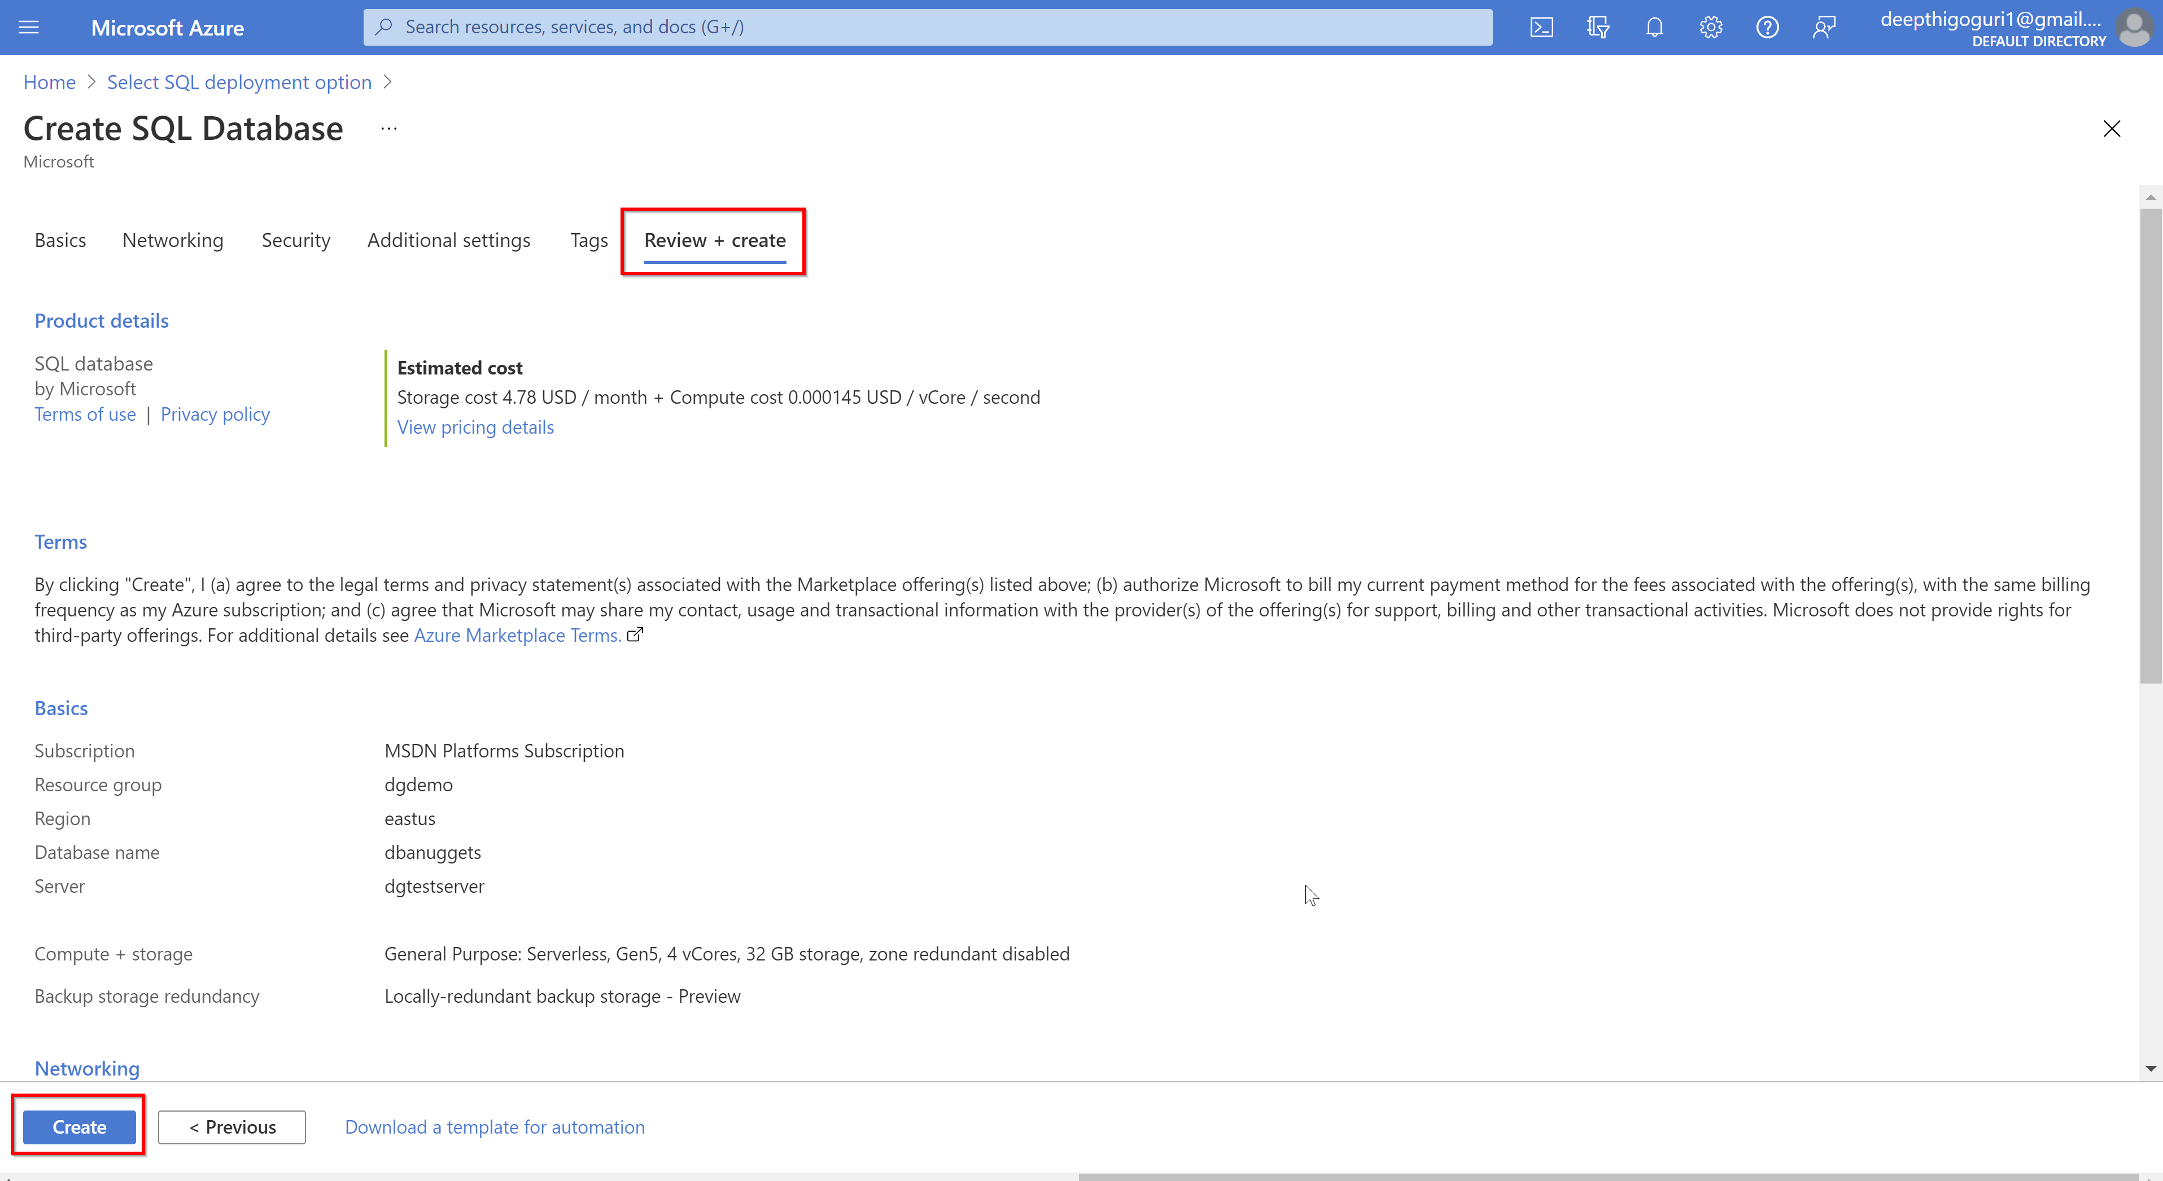

Slide 46
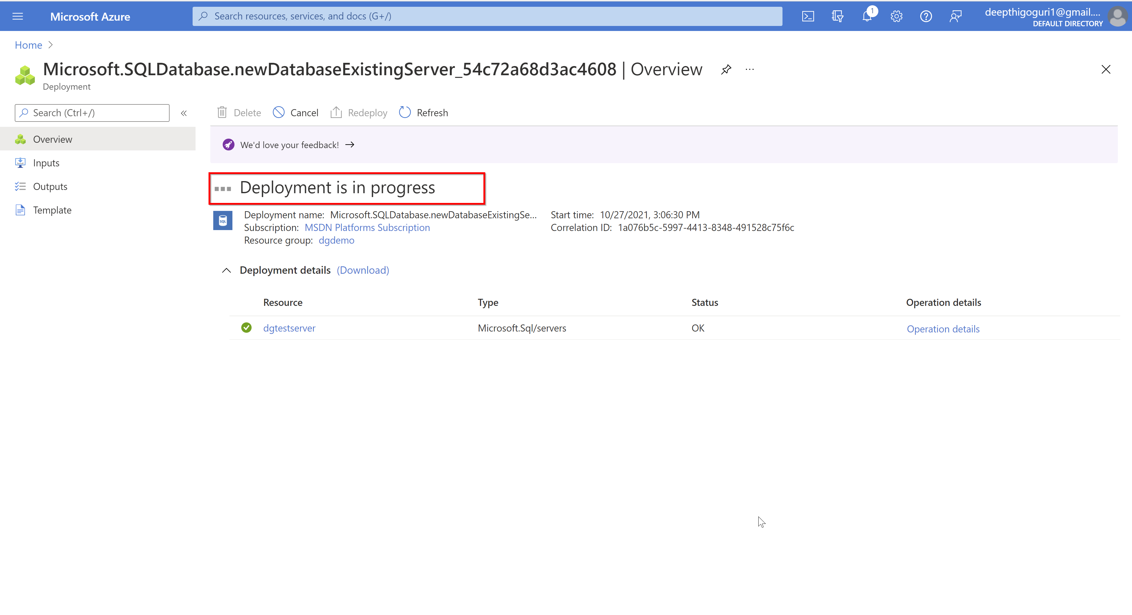

Slide 47
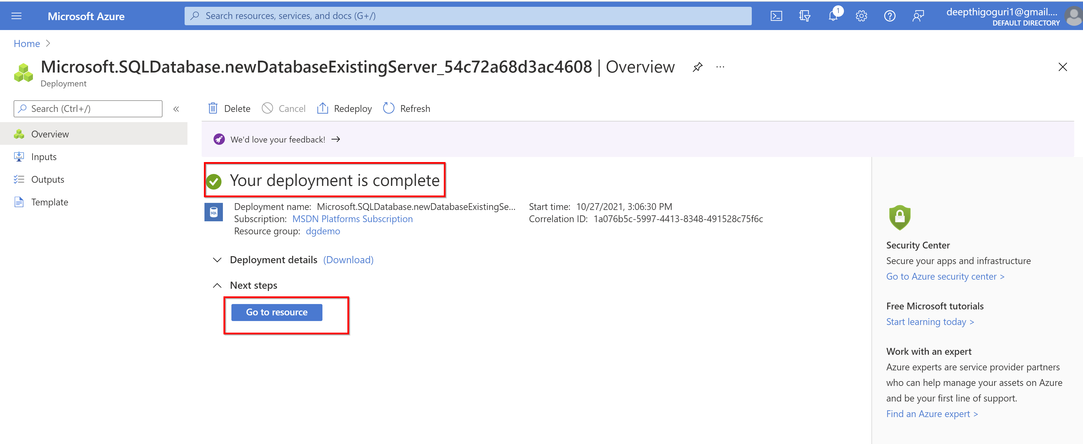

Slide 48
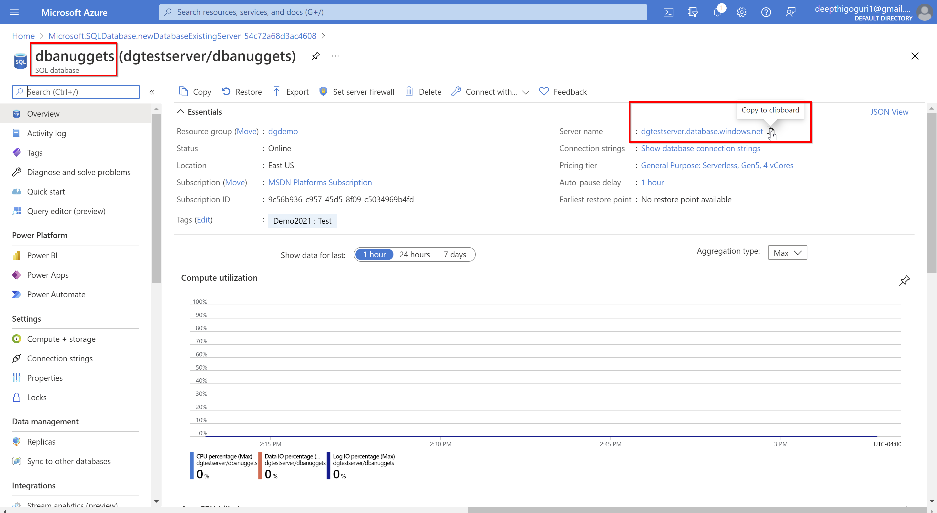

Slide 49
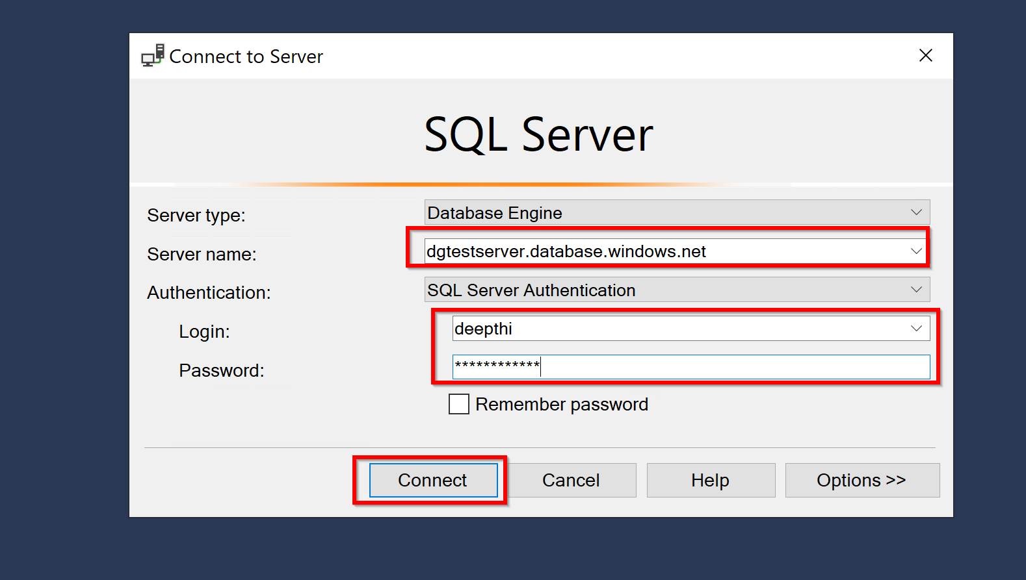

Slide 50
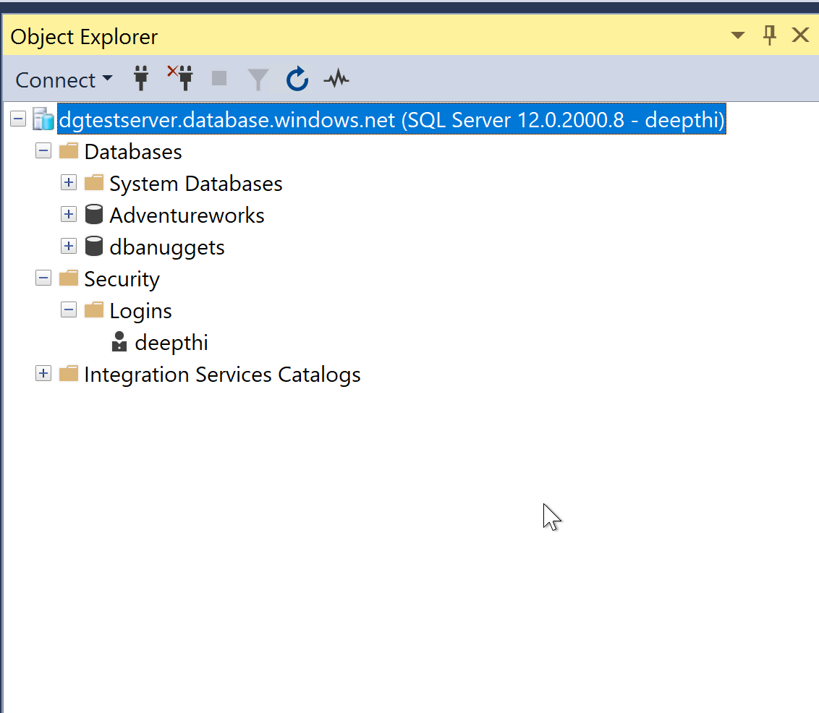

Slide 51
Move Databases to Azure
Several possiblities
Manually with Azure Data Studio
Online (minimal downtime)
Offline (downtime is not a consideration)
Scripting with PowerShell (still in preview)
Online (minimal downtime)
Offline (downtime is not a consideration)
Source:

Slide 52
Move Databases to Azure
Do assessments first to check if databases are eligible for its place
ADS and scripting path PowerShell/CLI are for scaled migrations
Source:

Slide 53
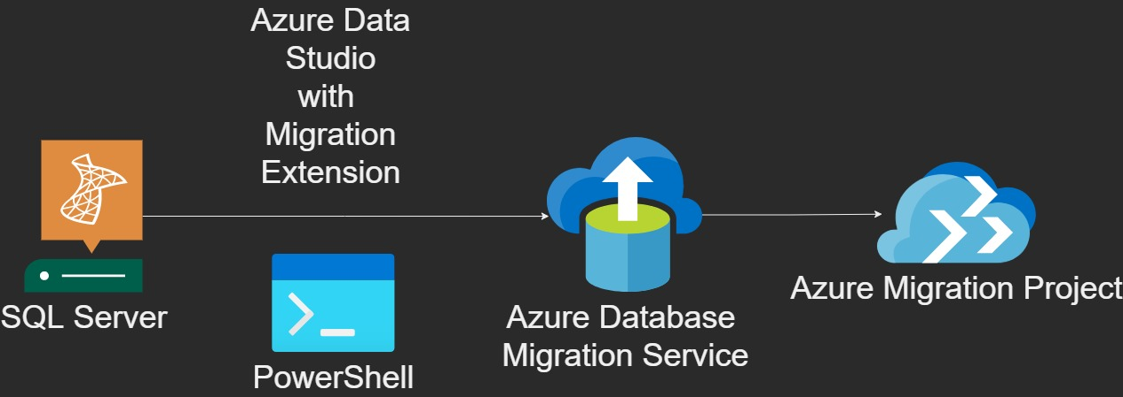
Move Databases to Azure
Source:

Slide 54
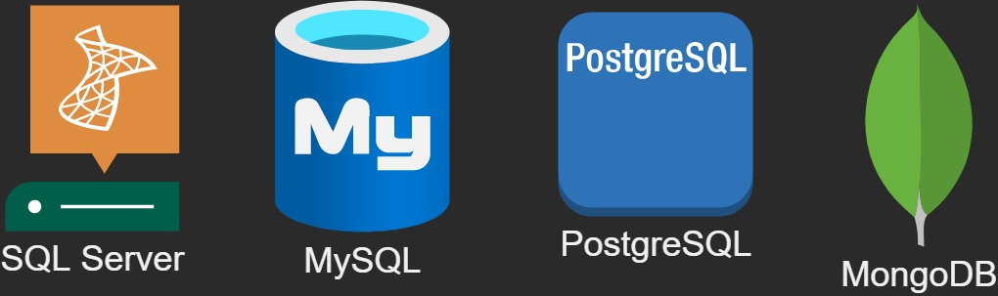
Move Databases to Azure
Its not just for SQL Server Databases
Source: https://docs.microsoft.com/en-us/azure/dms/resource-scenario-status

Slide 55
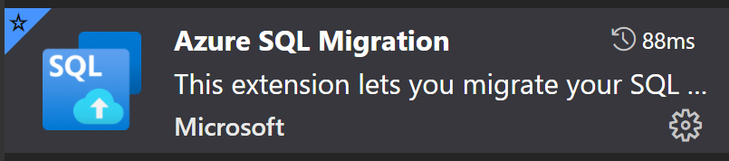
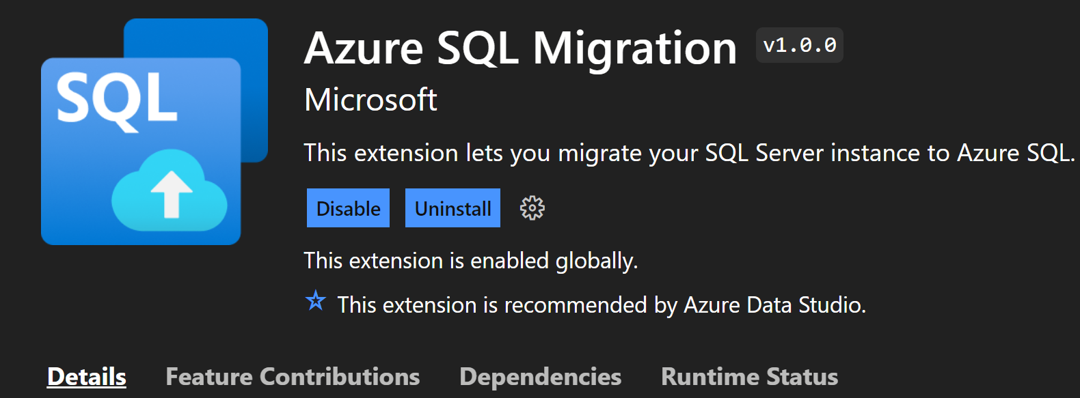
Move with Azure Data Studio
Get the plugin «Azure SQL Migration»
Source:

Slide 56
Move with Azure Data Studio
1. Create an Azure Migration Instance
Manually in Azure Portal
With ARM
Create it with Bicep 💪
2. Azure Managed Instance
3. Use Azure Data Studio and follow its Wizard
Source:

Slide 57

And what about PowerShell/CLI?
Still in Preview
How-To Guide: https://docs.microsoft.com/en-us/azure/dms/howto-sql-server-to-azure-sql-managed-instance-powershell-online
Source:

Slide 58
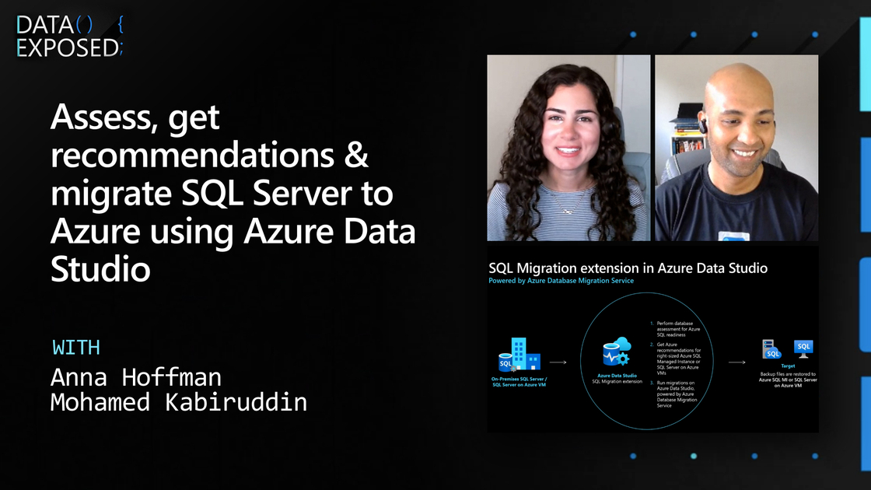
Demo by Microsoft available
Visit the very recently updated documentation sites, including https://docs.microsoft.com/en-us/azure/dms/migration-using-azure-data-studio

Slide 59
Fair warning for private users 💵
It’s relatively expensive (~USD 830++ / Month)
Set up a budget warning!

Slide 60
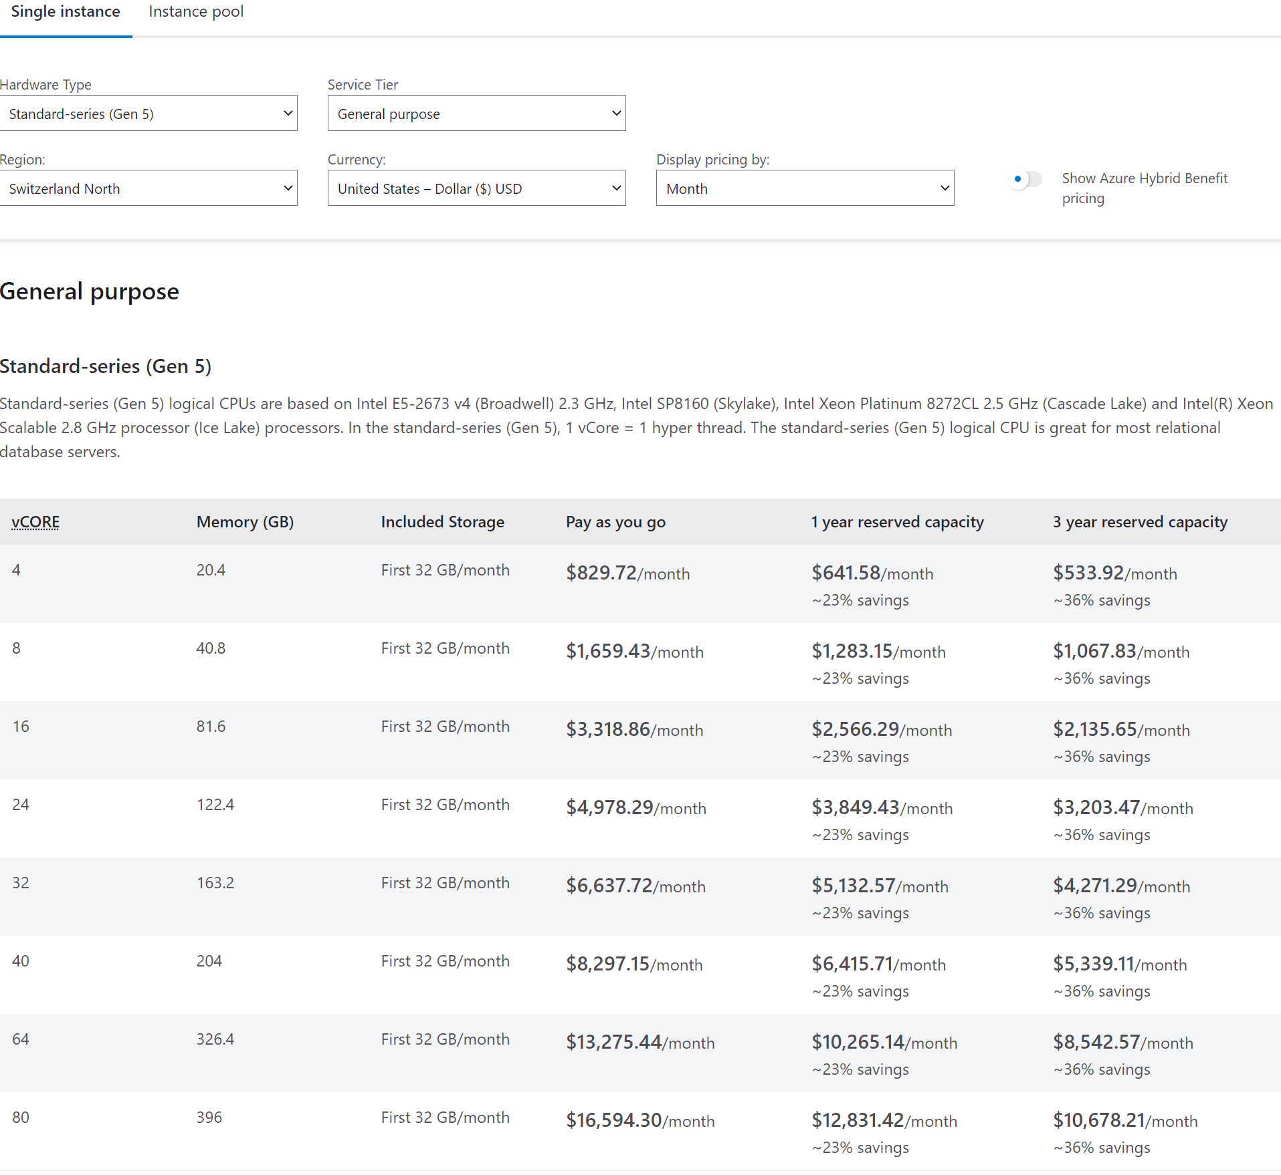
Source: https://azure.microsoft.com/en-us/pricing/details/azure-sql-managed-instance/single/
Prices as per 14.05.2022
If you can, try to get free Azure credits!

Slide 61
Resources
https://docs.microsoft.com/en-us/azure/azure-sql/database/service-tier-hyperscale
https://docs.microsoft.com/en-us/azure/azure-sql/database/serverless-tier-overview

Slide 62


💬Questions?
👩‍💻
Blog dbanuggets.com
@dbanuggets
deepthi@dbanuggets.com
linkedin.com/in/deepthigoguri/
github.com/DeepthiGoguri
🧑‍💻
Blog kayondata.com
@kaysauter
kay@kayondata.com
linkedin.com/in/kaysauter
Data TGIF: meetup.com/data-tgif
github.com/kaysauter
Notes:
If you have any questions after the presentation, feel free to contact me through one of those channels

